Slide 1
Primary Health Care Services in Jyväskylä Wellbeing Services County of Central Finland

Slide 2
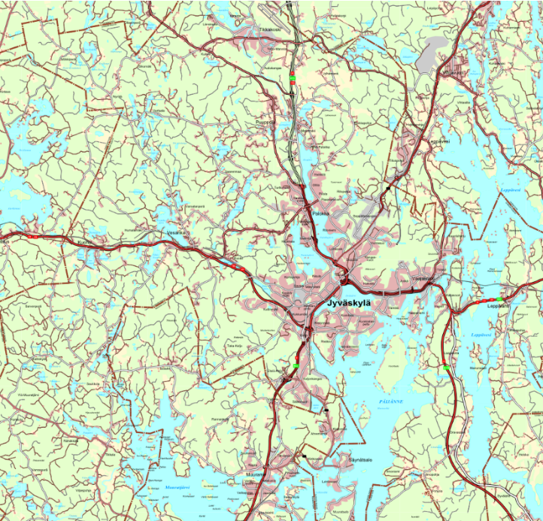
JYVÄSKYLÄ HEALTH CENTRES - LOCATIONS
8 Primary Health Care Centres in the area of Jyväskylä
(Huhtasuo, Korpilahti, Kyllö, Nova, Palokka, Sampoharju, Säynätsalo & Tikkakoski)
Urgent and Non-Urgent Care
Mon-Thu 8 am – 4 pm/8.00-16:00
Fri 9 am – 4 pm/9.00-16.00
1 Hospital: Nova (Hoitajantie 3)
Emergency Health Care and Specialised Health Care

Slide 3
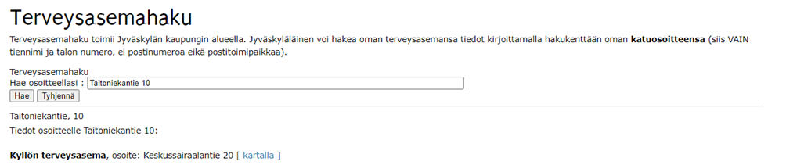
Find your health centre
You can find your designated health centre on the following web page:
https://www3.jkl.fi/sotepa/terveys/omalaakarihaku
Write down your home address (street name and number) on the white field, then press “Hae”

Slide 4
Kyllö and Nova health centre
Many of the student apartments are located in the areas of Kyllö and Nova health centres
Kyllö health centre/Kyllön terveysasema
Address: Keskussairaalantie 20, 40620 Jyväskylä
Phone number: +35814 266 2011
Nova health centre/Novan terveysasema
Address: Hoitajantie 3, 40620 Jyväskylä
Phone number: +35814 266 0120

Slide 5
The Opening Hours
The opening hours of health centres are
Mon-Thu 8am – 4pm/8.00-16.00 (Service Desk 12pm – 3pm/12.00-15.00 and first-aid 8am – 3.30pm/ 8.00-15.30)
Fri 9 am – 4 pm/9.00-16.00 (Service Desk 12pm – 3pm/9.00-15.00 and first-aid 9am – 3.30pm/ 9.00-15-30)
Outside of these hours you can contact Medical Helpline in number 116 117/visit hospital Nova emergency department.
In case of an emergency, call 112/visit hospital Nova emergency department.

Slide 6
Booking an appointment
By phone (in Finnish and in English): please wait on the line for the answer
Leaving a callback message: in urgent matters press 1, in non-urgent matters press 2. End the call only when the automatic message ends. (Automatic message is spoken in Finnish and the callback service only works from Finnish phone operators’ numbers.)
By service desk/first-aid (also in other languages): please take a service number from the machine and wait for your turn
We have interpreting services available in many languages
We are developing digital services with fast pace. At the moment digital services are available in Finnish in web page www.omaks.fi.
Please cancel an appointment you won’t be able to come to, phone number is +35814 2660161 (a fee for a missed uncancelled doctor’s appointment is €56.70)

Slide 7
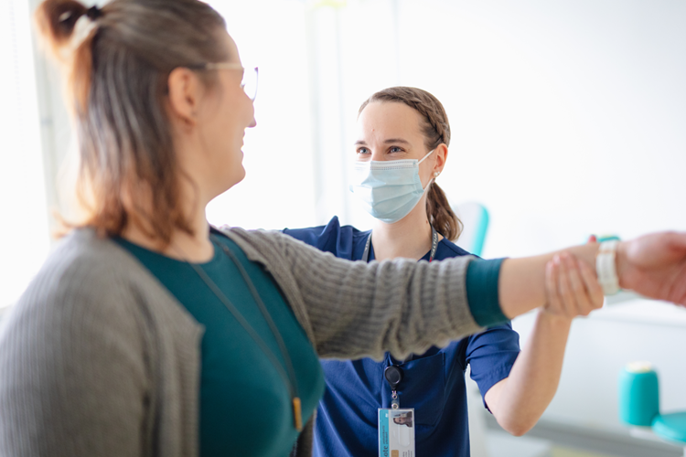
Assesment of treatment needs
When you contact health centre, a registered nurse will assess your treatment needs based on your symptoms
According to your symptoms you will be given an appointment time or contact details for the professional with best skills to help you (including nurses, doctors, physiotherapy services, mental health and substance abuse services, social workers and family planning clinic)

Slide 8
What to bring with you
Your ID, passport, certificates etc.,
EU-health insurance card/other health insurance card
Your contact details in Finland (phone number, address, email) and your address in your home country
Information of your former diagnoses, medications and nutritional supplements you might use
You can also prepare by writing down your symptoms: what, where, for how long etc.

Slide 9
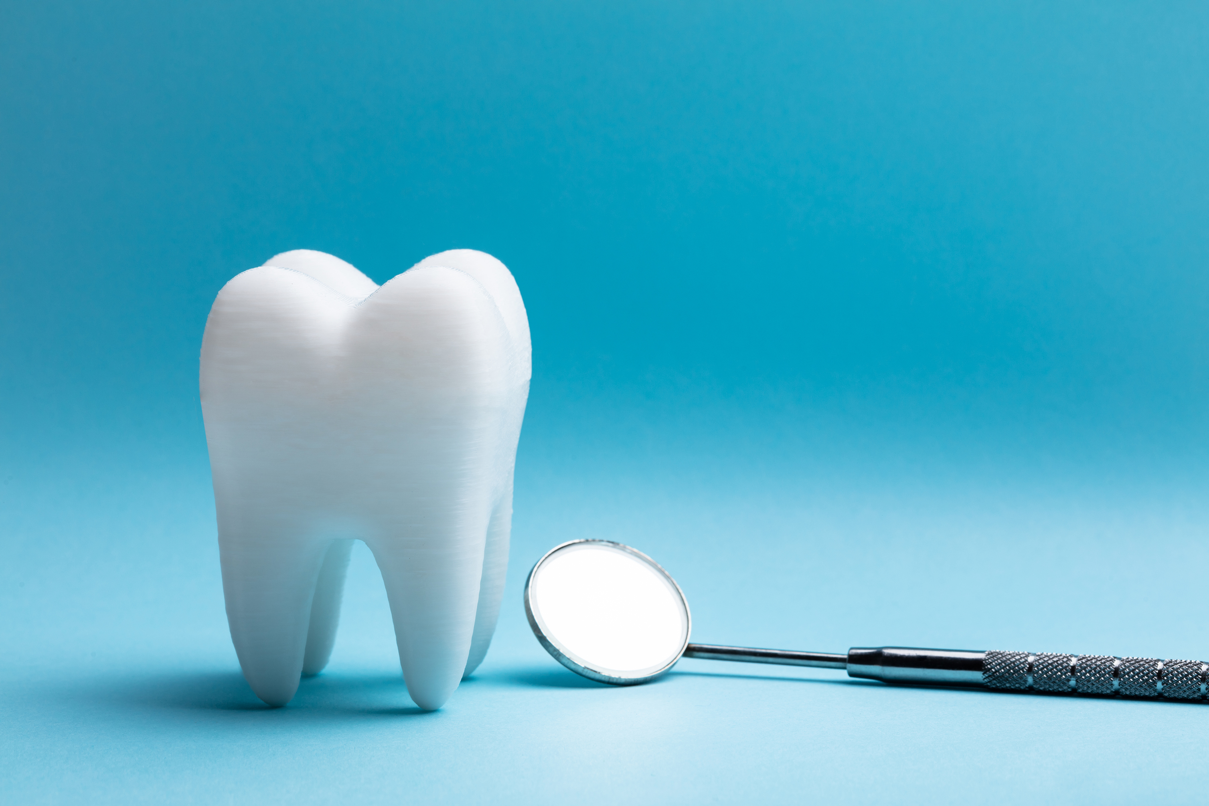
Dental care
There are several dental clinics around the city, service desk available in Kyllö Health Centre, second floor (Keskussairaalantie 20)
In urgent need (severe tooth ache, accidents) and non-urgent needs, call +35814 266 0126 Mon-Fri 8 am – 4 pm/8.00-16.00
In urgent need for dental care outside of these opening hours, call Medical Helpline 116 117

Slide 10
Family planning clinic
Family planning clinics provide services related to sexual health issues. The services include f.e. contraceptive advice, pregnancy planning and infertility treatments
Contact number +35814 266 2229/Mon-Fri 8.30 am – 10 am/8.30-10.00
Appointment visiting address (no service desk available)
Keskussairaalantie 20 40620 Jyväskylä

Slide 11

Medication and Medical Prescriptions
Prescriptions in Finland are electronic, written by a doctor or in some cases by a nurse with special training
Ask your doctor for a printed patient instruction sheet to buy your medicine with from the pharmacy
Medication can only be bought in pharmacies (apteekki in Finnish)
Some medicine is available without prescription, such as antihistamine, ibuprofen and paracetamol
Pharmacy employees will gladly help you if you have any questions

Slide 12
Customer fees
Fees for students from EU / ETA – country, Switzerland, Quebec Canada or Great Britain (same as citizens):
Nurse’s appointments in health centres are free of charge
Doctor’s appointment fee €23.00/visit
Physiotherapy €12.80/visit
No need for cash, an invoice will be mailed to your home address in a few weeks after the appointment
Your residence permit for studies requires you to have a private insurance that covers your medical and drug expenses
If you are coming from a country/area outside of those mentioned, you will have to pay the actual higher costs. In some cases private health care fees might cost less.

Slide 13
www.hyvaks.fi/in-english
Thank you! Stay safe and healthy!

