Slide 1
WORKING IN A CHANGING WORLD
9.6.2026 JYU Staff Week
Antero Holmila, Professor of History,
Department of History and Ethnology, University of Jyväskylä

Slide 2
Today
PART I: FROM MEGATRENDS TO TENSIONS
PART II: HIGHER EDUCATION – WHAT DOES ALL THIS MEAN
PART III: NOW WHAT?
Notes:
Today, I will do three things: First, I will sketch the global landscape not as a list of trends, but as a set of tensions. Second, I will reflect on what those tensions mean for our inner life as institutions. And finally, I will ask: So, now what? How do we protect the fragile core of our mission?

Slide 3
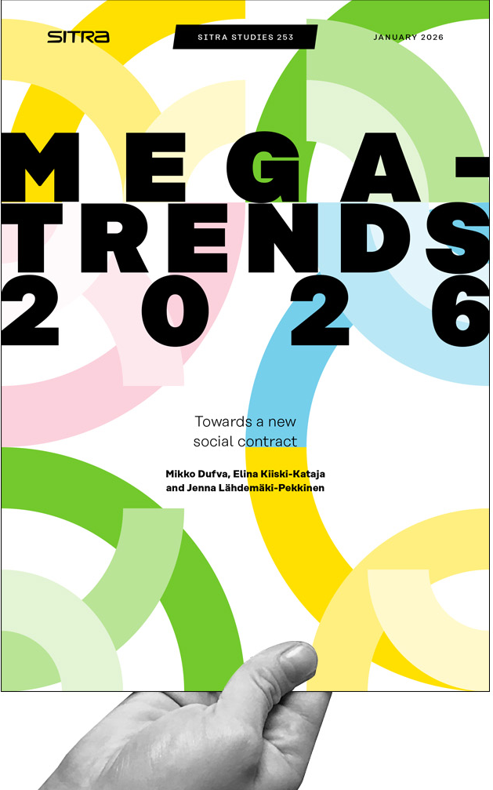
PART I: FROM MEGATRENDS TO TENSIONS
Megatrends shape the way in which the world is developing – and universities too
In this section:
  Megatrends
  What’s going on in the world?
  The 3rd wave of autocratization
  Technological disruption – AI revolution?

Slide 4
Megatrends
Price Waterhouse Coopers (PWC 2022):
“Deep and profound trends, global in scope and long-term in effect, touching everyone on the planet and shaping our world for many years to come. It is now clear that these Megatrends have transformed our world even faster than we predicted. Largely this is due to the interaction between the trends, which has turbocharged both the speed and pervasiveness of change.”
PWC (2026 – same as 2022):
Climate change
Technological Disruption
Demographic Shifts
Fracturing World
Social instability
Big drivers that will shape our personal and institutional lives

Slide 5
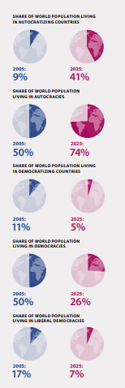
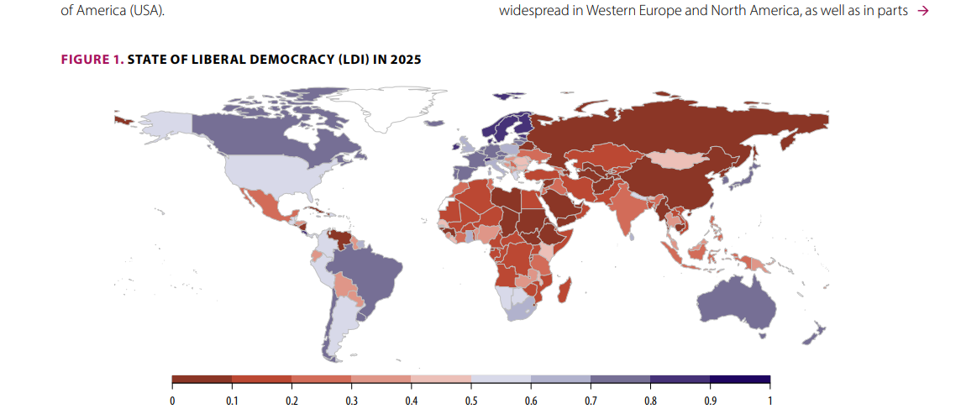
What’s going on? The 3rd wave of autocratizing
Source: V-Dem Democract report 2026: https://www.v-dem.net/documents/75/V-Dem_Institute_Democracy_Report_2026_lowres.pdf
Notes:
Kaikki keskeiset indeksit (esim. V-Dem; EIU; World Justice Project; CIVICUS, Freedom House): Demokraattiset vapaudet laskussa 2010-luvulta alkaen:
Media
Oikeusvaltio
tasa-arvo & yhdenvertaisuus
poliittiset oikeudet
Among other things, the article compares the last 25 years’ “third wave of autocratization” to the “first wave” in the 1930s winding up with the end of World War II. The analysis provides evidence that the current wave of autocratization is unprecedented in length, scope, and magnitude – worse than the 1930s in all these regards.

Slide 6

What’s going on? The 3rd wave of autocratizing
Background: the “age of crises” since 2008 (global financial crisis, Arab Spring, refugee crisis, climate crisis, COVID, Ukraine)
A backlash against the post–Cold War hubris of democracy and globalization
  Democracies’ ability to respond questioned → declining trust and confidence
  Transformation of the media; information used as a weapon → polarization
  Uneven distribution of economic growth → exclusion and resentment
  Populist leaders & rhetoric: If democracy does not “work,” why do we need it? → agenda of weakening democracy
Source: CNN / Tyrone Siu Reuters

Slide 7
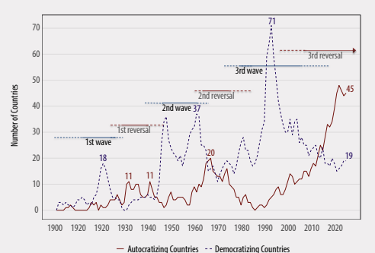
What’s going on? The 3rd wave of autocratizing
Alternatives “illiberal democracy” and “autocracy” → a continuum, not a dichotomy
Illiberal democracy:
  Institutions exist (media, elections, judiciary), but functions eroded
  no longer serve pluralistic democratic values; instrumentalized to strengthen those in power (e.g. India, Hungary, Turkey)
Autocracy:
  No elections, or only symbolic ones; the government is above the law; no opposition or civil society; strong state control (e.g. Russia, Saudi Arabia, North Korea)
“The analysis provides evidence that the current wave of autocratization is unprecedented in length, scope, and magnitude – worse than the 1930s in all these regards.” (V-Dem Democracy Report 2026, 18).

Slide 8
From megatrends to tensions
Not only an era of ”autocratizing” – But an era of transformation & contradictions, pulling in different directions
  More knowledge than ever before ←→ increasing disagreement over ”truth” (n.b. post-truth era)
  Economic and technological interconnectedness ←→ political fragmentation
  Technological acceleration ←→ many institutions – universities – remain slow & path-dependent
  Increasing awareness of security issues & threats ←→ democratic systems becoming more fragile
Not about understanding ”complexity” – but understanding ”tensions” – not easy to reconcile
And universities?
  Among first to be affected – funding dependencies, regulation, expectations of what should be studied and researched
Universities not only observing democracy & authoritarism BUT part of arena where these trends play out

Slide 9
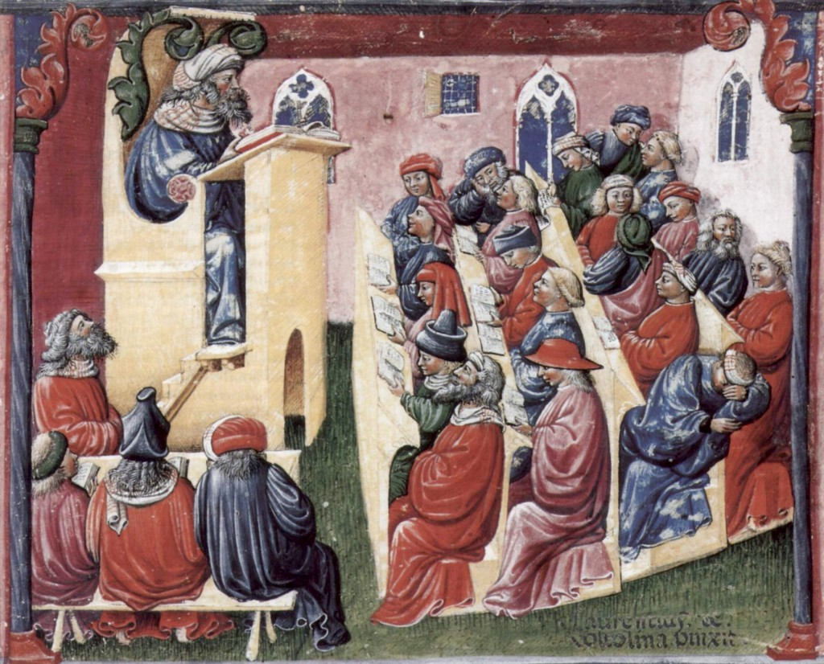


”Technological disruption” – AI revolution?
What exactly is AI changing about the core activities of universities?
AI can: summarise literature, generate text, assist in coding, support teaching, produce research ideas, identify literature gaps… write student essays… → WHAT REMAINS UNIQUELY ACADEMIC?
This is not a technological question, but existential for all universities
Digital connectedness vs. human connectedness? – not one or the other, but both
Laurentius de Voltolina: Liber ethicorum des Henricus de Alemannia, single sheet. Scena: Henricus de Alemannia con i suoi studenti, ca. 1350 (Wikimedia commons)

Slide 10
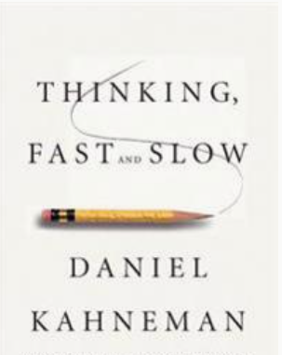
PART II: HIGHER EDUCATION – WHAT DOES ALL THIS MEAN?
World is changing – and so are universities
Question to be asked = not only what they do, but how they function
In this section:
  Thinking ”fast and slow”
  Seeing the world, a.k.a. ”academic bias”
  Thinking critically: two sides of education
  The internal transformation of universities (from slow to fast)
Notes:
Argument that universities have lost direction or sense of meaning, is a wrong one. Purpose of university is really simple, and has not changed. More precisely, those who are most heavily invested into ”what universities are” have lost voice and ability to influence and direct. Hence the sense of lost direction.

Slide 11
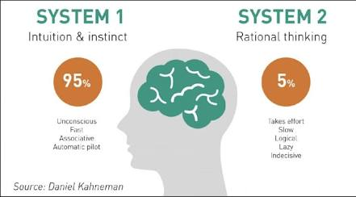
Thinking fast and slow – University as ”slow institution”
Universities as ”slow” (reflective, careful, deliberative, ”objective”)
  Historically it’s strength
Today’s context (&megatrends)
  Fast public debate, instant opinions
  Decision-making cycle shorter (politically also polarized)
  Expertise eroding & challenged, social media ”experts”, conspiracy theorists
Tension: how can a slow-thinking institution remain relevant?
Or even: are universities becoming too slow not only to respond but to matter? (trust in academia fast sinking)
Transition towards ”fast” endangers the quality of self-reflection

Slide 12
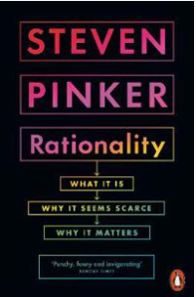
Seeing the world - academic bias
We are not good at recognizing our own faults, but good at pinpointing others – institutions do just that
University as ”as rational collective”
”Transition towards ”fast” endangers the quality of self-reflection”
Example 1: scientists perform NO better in true-false climate questions than climate deniers (Steven Pinker)
What (according to studies) predict climate denialism?
Example 2: Monkies vs. well-educated about world data (Hans Rosling)
Example 3: ”the rationale of education”
Notes:
”Rationality under threat: Steven Pinker: on academic freedom at dissident dialogues”
Today: growing belief in conspiracy theories & alternative explanations – human’s don’t reason according to normative models like logic, probablility, correlation&causation etc. But also according to intuition, beliefs, biases, heuristics → irrationality is part of human nature, also among academics, i.e. supporting evidence is thought to confirm with one’s expectations
– human’s don’t reason according to normative models like logic, probablility, correlation&causation etc. But also according to intuition, beliefs, biases, heuristics → irrationality is part of human nature, also among academics, i.e. supporting evidence is thought to confirm with one’s expectations
Paradox: climate scientists perform NO better in true-false climate questions than climate deniers
What (according to studies) predict climate denialism? It’s not knowledge or education but political orientation → Daniel Kahani ”expressive rationality” – loyalty to social coalition
If we all have clear conformation biases, how do we achieve rationality? Investing into rationality-pomoting institutions – why? because ”self-corrective” mechanisms

Slide 13
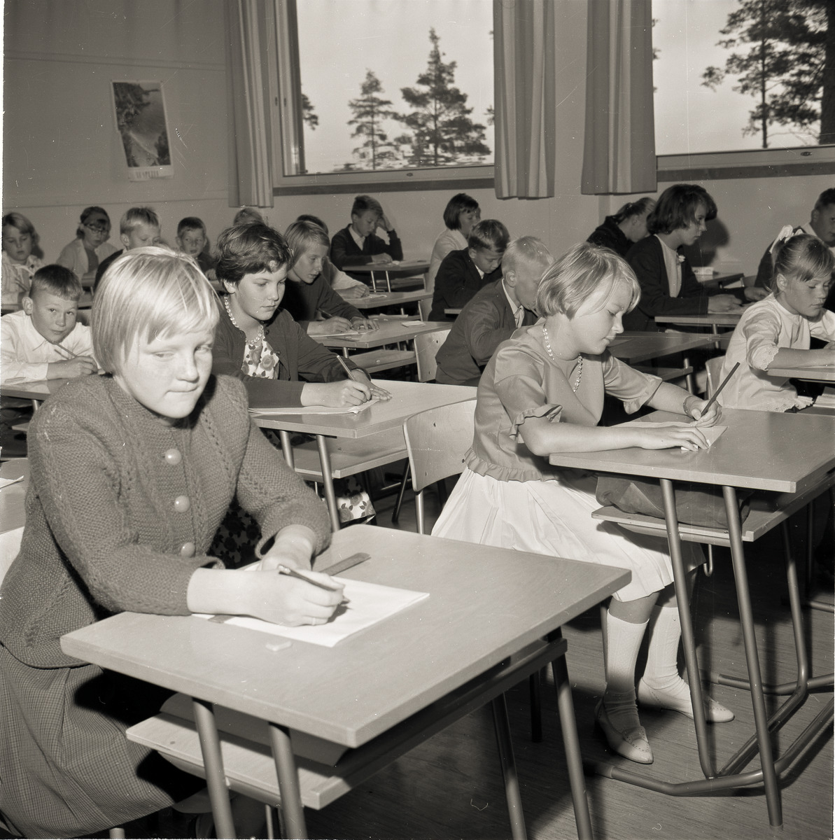
Thinking critically: two sides of education
Education traditionally seen as:
  A tool for social mobility
  A mechanisms of equality
  A foundation of shared understanding
All these claims are valid and supported by scientific evidence
In Finland, education is part of our national metanarrative
But – also another side to the story – more evident in the last 10 years or so…
Exams in Lappeenranta, 1962. Source: Etelä-Karjalan museo
Notes:
Think about exchange students – what do they experience? A lot. All invaluable, but mainly from within the bubble they are already being socialised. The same is true for professionals, like me.

Slide 14
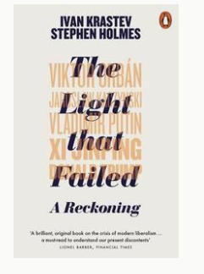
Thinking critically: two sides of education
Education is one of the drivers of polarization – how & why?
  Higher education is not only about knowledge transfer
  Shapes values, worldviews and identities
  Think about exchange students – what do they experience…
  Education not only integrate, but also separate
Ivan Krastev & Stephen Holmes, A light that failed 2019:
  Educated as the winners of the Cold War & globalization
  Cosmopolitan educated elites vs. less-educated locally rooted populations (”left behind”)
  Education has (unwittingly) created a gap – not just income gap, but a gap how ”reality” is interpreted
Highly educated people not ”less polarized”
Dan Kahan: educated people are good at arguing, but argument used for defending identity, not truth
As university life is getting ”faster” – we are also losing the sight of self-reflection
Notes:
Think about exchange students – what do they experience? A lot. All invaluable, but mainly from within the bubble they are already being socialised. The same is true for professionals, like me.

Slide 15
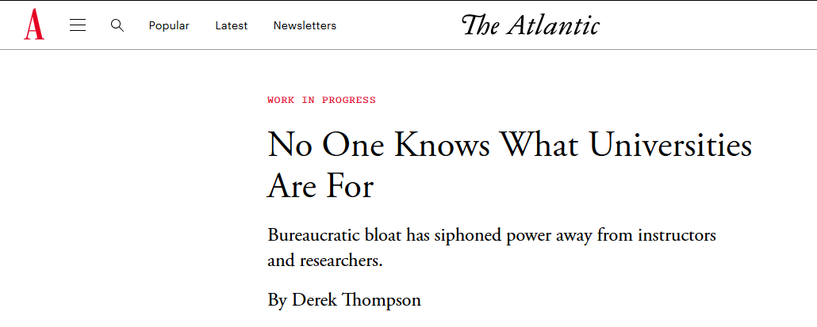
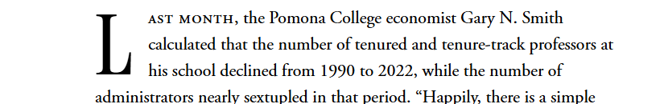
Internal transformation of universities (from slow to fast)

Slide 16
Internal transformation of universities (from slow to fast)
Gradual but real shift inside universities: from knowledge creation & teaching towards:
  Strategy, performance measurement, administration and institutional development
  Growth in administrative structures, increasing reporting, proliferation of strategies, KPIs etc.
Risk: optimizing measurable performance, not intellectual work.
Paradox: Expectation of more knowledge while time for its production is reduced.
TIME is the most important resource universities have and it is most severely affected.
  Deep thinking, sustained inquiry, teaching engagement all require time

Slide 17
Transition: external world and internal change come together – at a critical juncture in history
In a fragmented and changing world universities:
  Among the few transnational institutions
  Central to knowledge production & validation
  Are expected to be trusted source of expertise
At the same time:
  Politics challenging institutional autonomy
  Polarization challenging shared knowledge
  AI challenging traditional forms of expertise
Externally: expectations placed on universities are increasing – but internally our capacity is diffusing;
Especially the core functions of teaching and research have been decreasing in importance

Slide 18
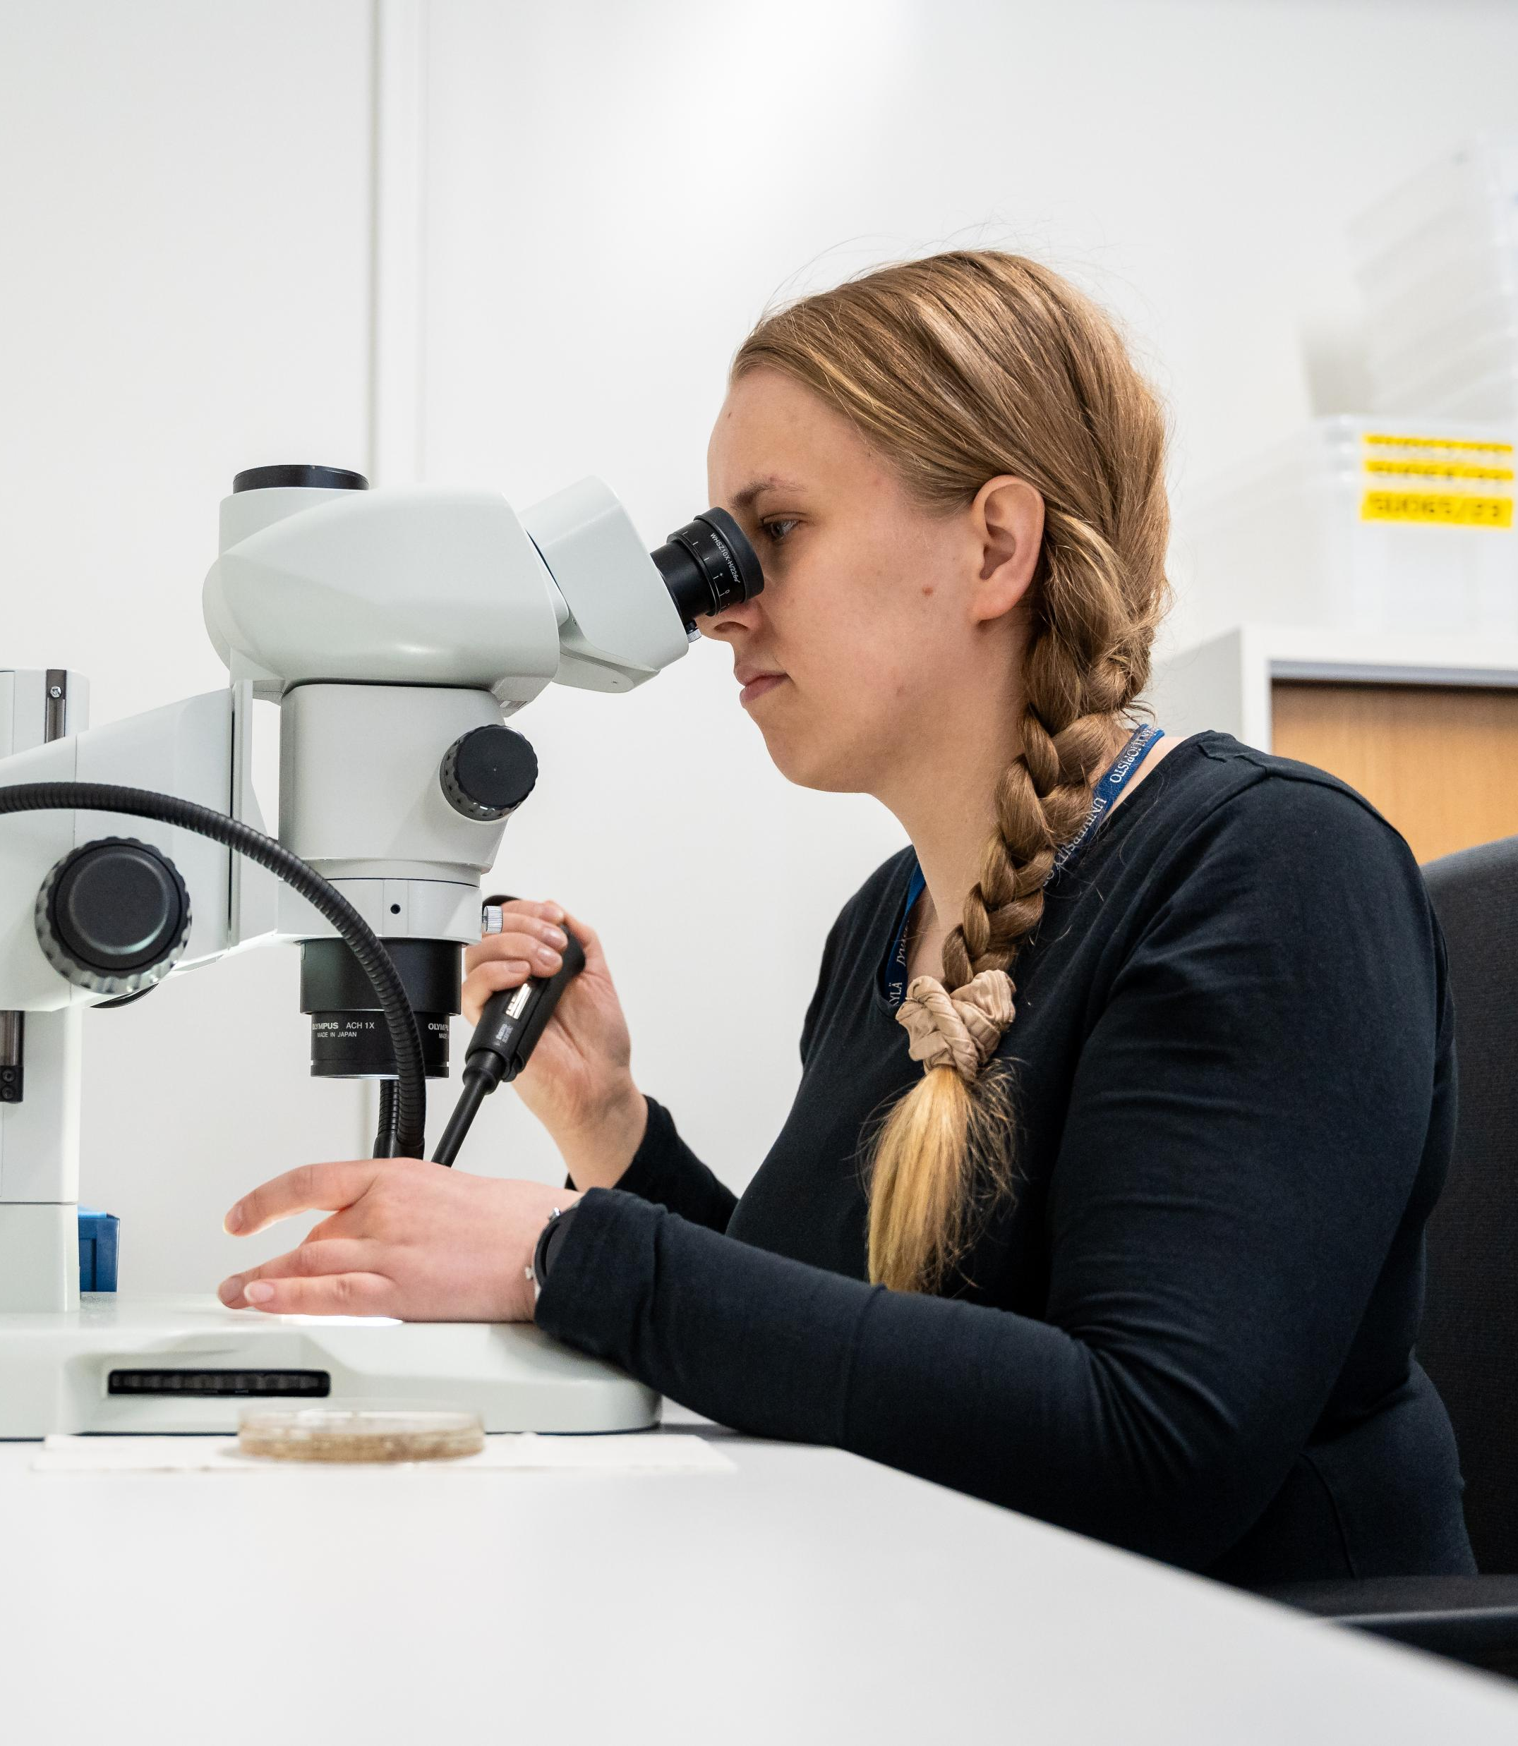
PART III: NOW WHAT
A few provocations – not solutions but challenges for reflection

Slide 19
Provocation 1: Universities must stop optimizing what does not matter
Universities have become very good at:
  Measuring, reporting, delegating, networking, planning, benchmarking
We should ask: What would happen if we stopped doing (or radically reducing) some of these things?
Key concrete question to ask: Which activities create the most value for knowledge and learing AND which activities exists for other purposes?
Danger: Optimization of systems that are indirectly connected to our core purpose

Slide 20
Provocation 2: Treat academic time as a scarce resource
TIME is the most limited resource in universities AND YET, it is treated as infinitely flexible
  Administrative expansion, coordination and planning demands, strategic work: They all consume time
  Question which is asked all the time (by non-academic staff): ”How do we improve systems to becaome more efficient”
It is a wrong question. Instead, the key question to ask is: How do we protect time for thinking, research, and meaningful teaching (especially in the era of the AI)
Danger: If we fail this, we will undermine the core activities that justify the existence of universities

Slide 21
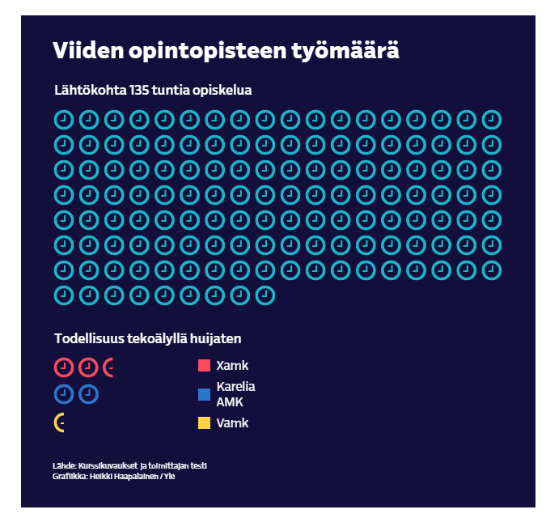
Provocation 3: Define what humans do better than AI
“A Yle journalist enrolled as a student in three universities of applied sciences. It turned out that remote courses in the healthcare field are really easy to pass by cheating with AI.”
AI can process information faster, generate text easily, support analysis OR be used as a tool to pass exams, tests etc…
Universities must clarify (and not just with ”instructions how to use AI”):
What is uniquely human and uniquely academic
  My take: it’s a community of people investing in learning through personal contact, judgement & reasoning through deliberation, challenging accepted ideas and testing new ones. Intellectual courage.
Danger: If we fail to think this through we risk creating a model where universities compete with technologies on the wrong terms – certainly on terms not defined by universities themselves
Yle, 5.6.2026 (https://yle.fi/a/74-20224850)
Notes:
Georgian sota, Arabikevät, Syyrian sisällissota, Krimin valtaus
Finanssikriisi, EU:n legitimiteettikriisi, pakolaiskriisi, Brexit
Ympäristö- ja ilmasto, Covid-19, digitaalinen murros

Slide 22
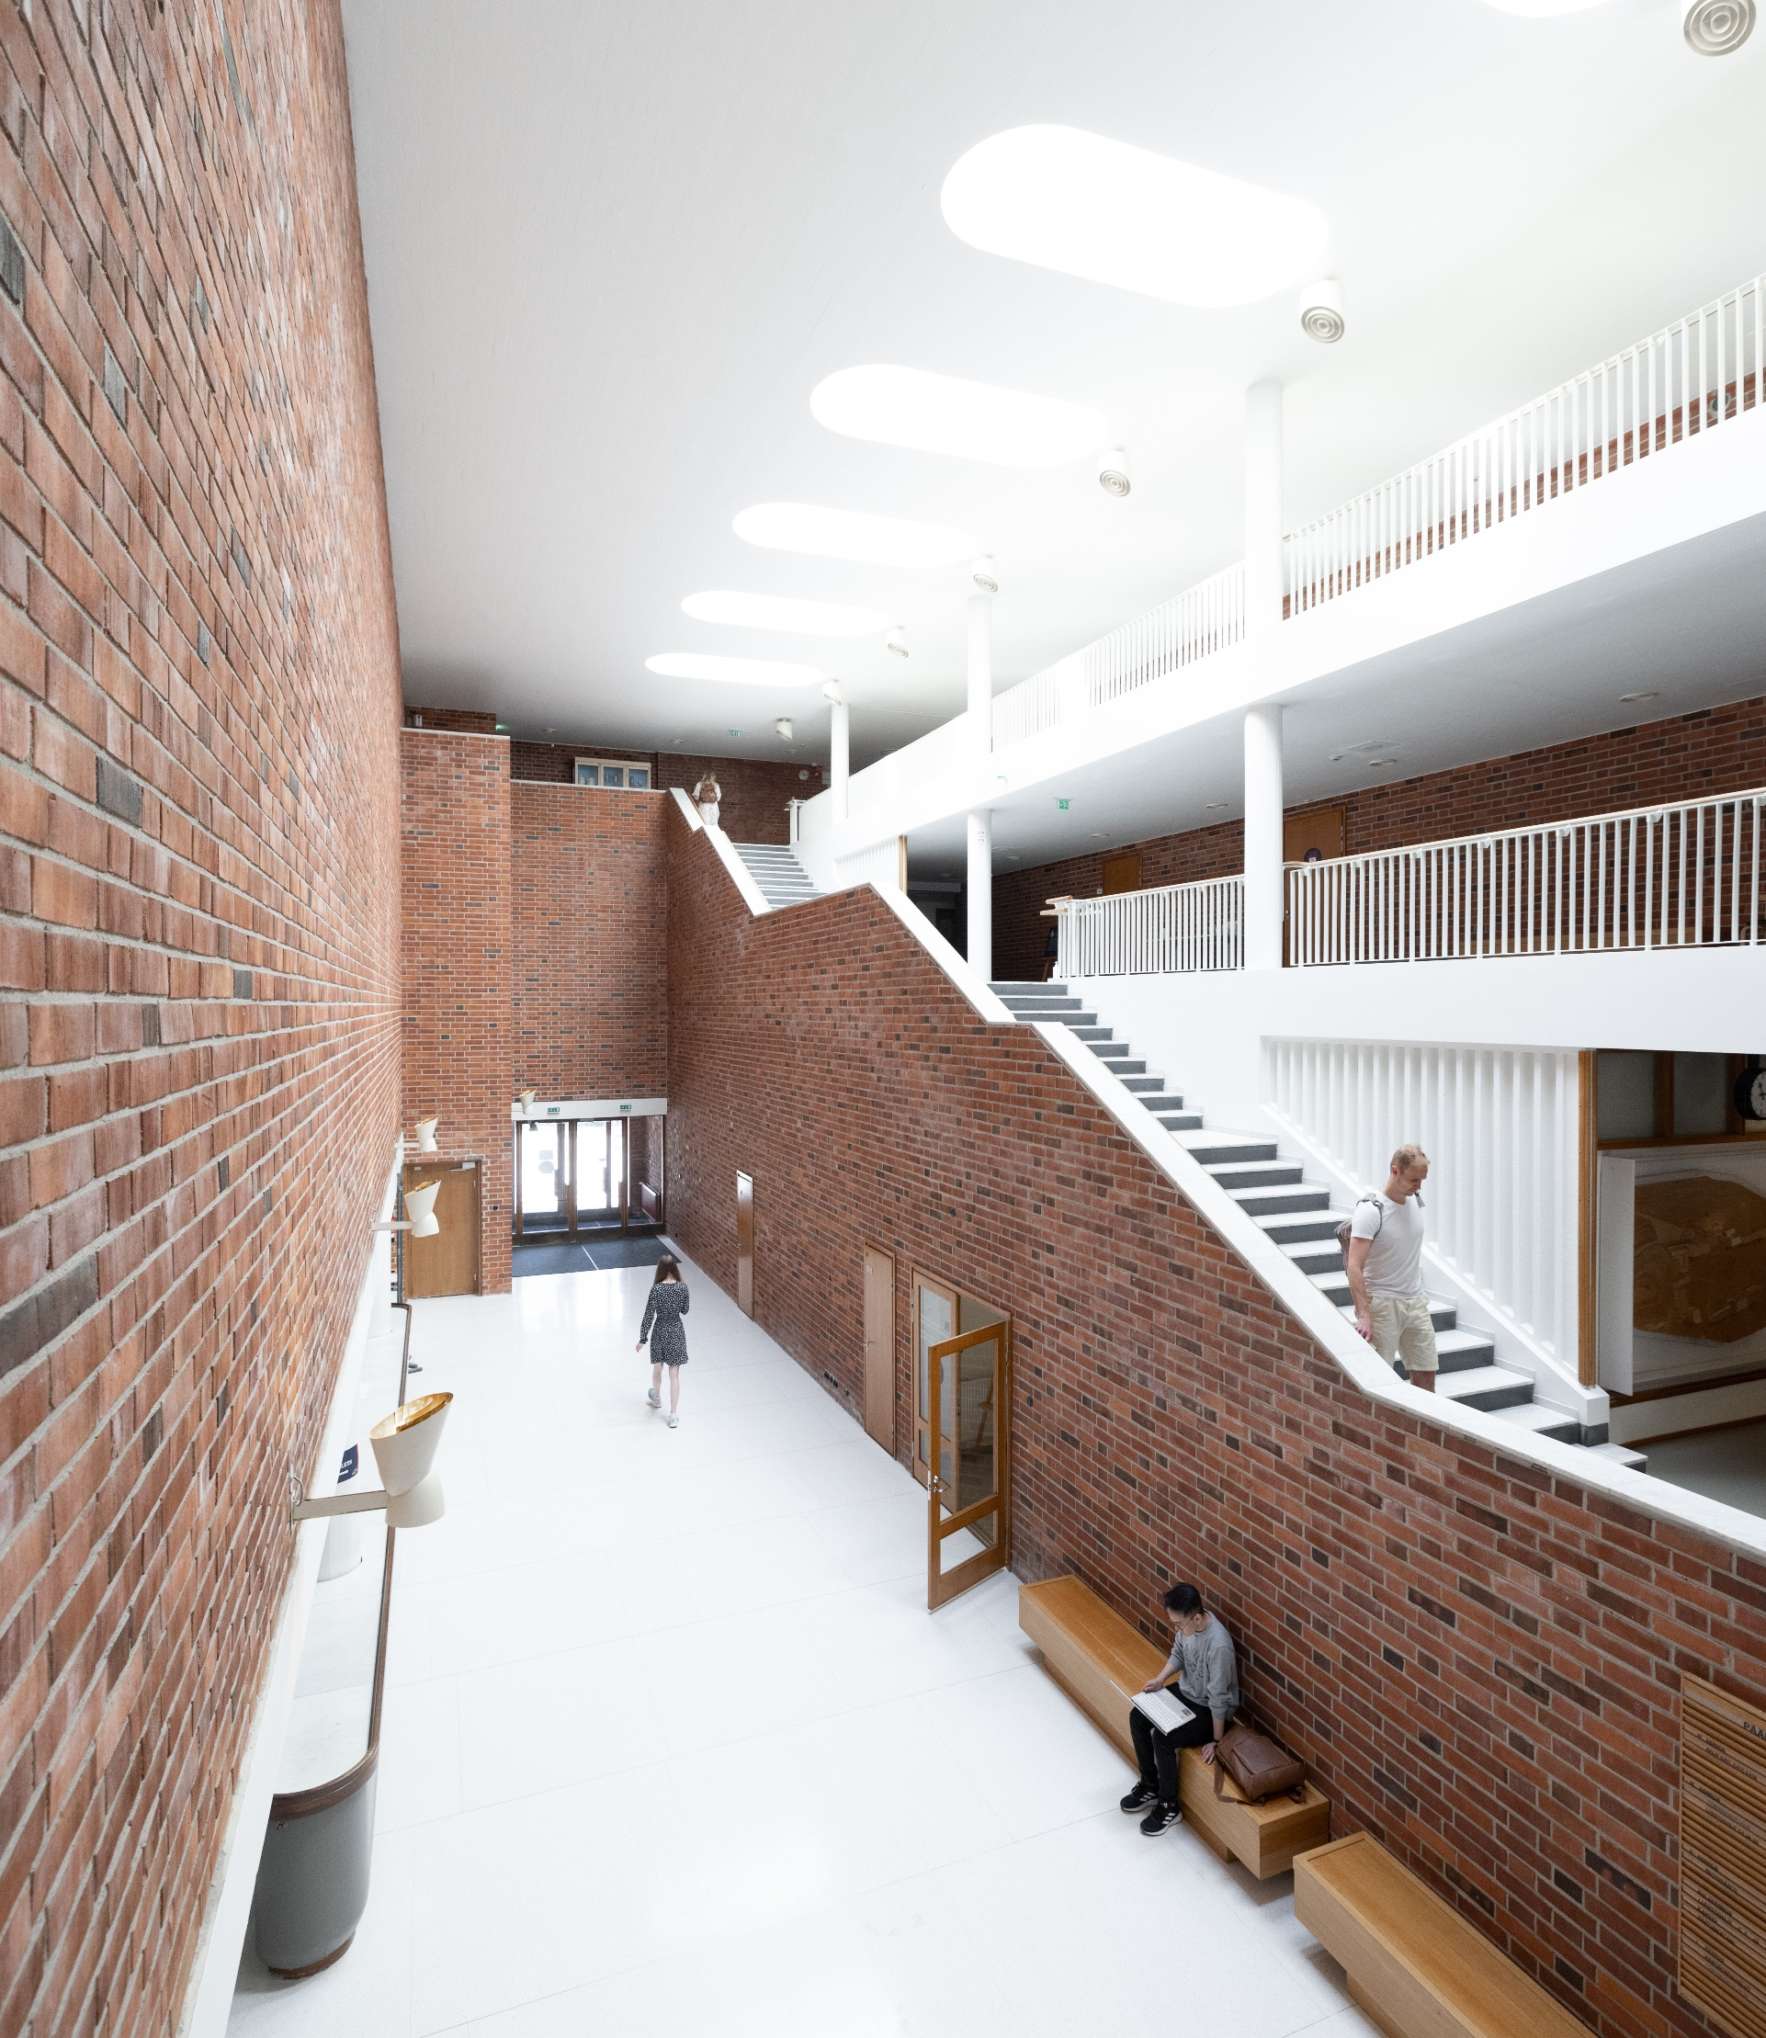
Final provocation: Re-centering the mission
At the core, universities exist to:
  Create knowledge (research)
  Transmit knowledge (teaching)
  Critically engage with society (outreach)
These functions are increasingly challenged, but lets stop here and phrase this differently:

Slide 23
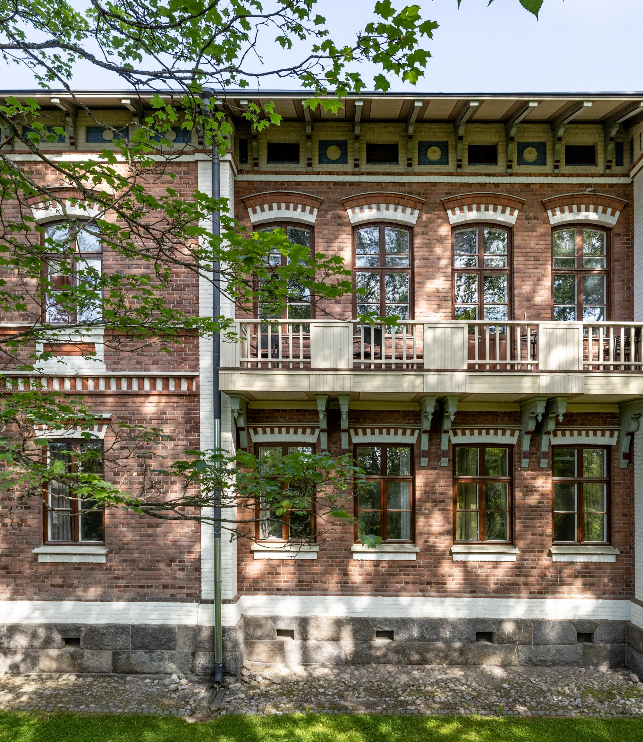
Final provocation: Re-centering the mission
Let’s imagine that universities disappear tomorrow
Society would have to re-build their basic functions asap:
But which functions would it build? Would all functions be re-build or would some functions just disappear unnoticed?
So, I close with this thought:
Our primary question should NOT be ”How do we manage universities better?” BUT
”What is essential”.

