Slide 1
Welcome to the Staff Week and the University of Jyväskylä!
8 June 2026

Slide 2
What happens today?
12:00-12:15 Introduction of the Staff week participants
12:15-13:00 Introduction to the Staff week and JYU
13:00-14:00 Lunch
14:00-15:00 Crash course into the Finnish language
17:30-22:00 Finnish well-being experiences (Viilu, Satamakatu 10)
  18:00 buffet
  19:00 sauna or singing bowl meditation

Slide 3
Introducing ourselves
JYU team organising the Staff week
We will do a quick roll call of the participants
  We will have more time to get to know each other later at Viilu ☺
  Please also feel free to introduce you on the WhatsApp group!

Slide 4
CY Paris Cergy University
Aida Dama, Albanian University, Albania
Anja Cenameri, Albanian University, Albania
Erda Qorri, Albanian University, Albania
Glorja Demika, Albanian University, Albania
Daniella Jones, Univesity of Klagenfurt, Austria
Loïc Hennemont, IHECS, Belgium
Craig Tokuno, Brock University, Canada
Barbora Strnadová, Masaryk University, Czech Republic
Audrey Ovet, Université Bourgogne Europe, France
Bernhard Altheim, Université Bourgogne Europe, France
Galeane Chaneac, CY Paris Cergy University, France
Kristine Chikhladze, Ivane Javakhishvili Tbilisi State University, Georgia
Alice Aliukwu, Johannes Gutenberg University, Germany
Marc Theis, Johannes Gutenberg University, Germany

Slide 5
Rebekka Pietschmann, Univesity of Erfurt, Germany
Heike Rosenberger, University of Erfurt, Germany
Madeleine Füldner, University of Erfurt, Germany
Anthony Gachanja, Jomo Kenyatta University of Agriculture and Technology, Kenya
Gerryshom Munala, Jomo Kenyatta University of Agriculture and Technology, Kenya
James Raude, Jomo Kenyatta University of Agriculture & Technology, Kenya
Moses Mucugi Njire, Jomo Kenyatta University of Agriculture and Technology, Kenya
Ngumba Elijah, Jomo Kenyatta University of Agriculture and Technology, Kenya
Justina Krauledaitė, Vilnius University, Lithuania
Paweł Andrejczuk, University of Opole, Poland
Nika Tomšič, University of Maribor, Slovenia
Peter Bernad, University of Maribor, Slovenia
Susa Van Dyk, University of the Western Cape, South Africa
Oscar Josep Tarí Velando, University of Valencia, Spain
Susana Cazorla, University of Valencia, Spain

Slide 6
Anastasiia Pertrus, National University Kyiv-Mohyla Academy, Ukraine
Alla Nahirna, National University of Kyiv Mohyla Academy, Ukraine
Liudmyla Titova, Kharkiv National University of Radio Electronics, Ukraine
Mariia Golovianko, Kharkiv National University of Radio Electronics, Ukraine
Vira Kovalenko, Ivan Franko National University of Lviv, Ukraine
Liana Moskalyk, Ivan Franko National University of Lviv, Ukraine
Emilia Villa Martínez, Universidad de Montevideo, Uruguay
Pilar Aznarez, Universidad de Montevideo, Uruguay

Slide 7
Introducing JYU Staff week of 2026

Slide 8
Introduction to the Staff week of 2026
During Mon 8 – Fri 12 June – we hope you will attend all the sessions and meetings as well as you can
We have tried to fit in some free time into the schedule as well
Many interesting common sessions for all participants
  E.g. Finnish crash course, walking tour on JYU campus, Knowhau, Wrap-up session…
  Evening get-togethers on Mon and Wed
Three tracks (sessions on Wed and Thu):
  Track 1: Managing student mobilities (coordinated by International Office)
  Track 2: How to promote interdisciplinary and impactful research on wellbeing (coordinated by JYU.Well)
  Track 3: Sharing and creating good practices to plan and implement international joint and double degree programmes in universities (coordinated by the team of Support Services for Internationalisation)

Slide 9
Some practical instructions 1/2
Materials:
  All materials presented during the Staff week will be stored and shared with the participants after the event
Certificates/agreements:
  If you have some agreements/certificates to be signed for your home university, you can leave them to Ellinoora after this session or later during the week > we will sign them and return them to you on Friday
  We will also prepare a certificate of attandance to all of you and give it to you on Friday

Slide 10
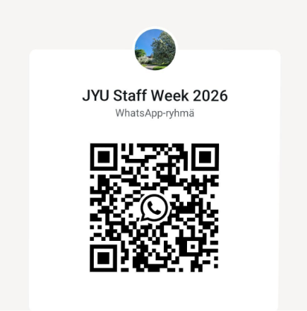
Some practical instructions 2/2
Whatsapp group for Staff week participants
Material packages
  Programme, campus map, contact info, wifi
Drinking water:
  Yes, you can drink the water from the tap, so you can utilise the bottle you received when checking in to the Staff week.
Feel free to ask any questions/guidance from the JYU Staff during the week! Generally Finns are really eager to help, so feel free to ask guidance from anyone if you e.g. cannot find the right place.

Slide 11
Introducing the University of Jyväskylä

Slide 12

City of Jyväskylä – The best place to study
The seventh largest city in Finland, over 144 000 inhabitants
  The population with an immigrant background increases from year to year
Student city, long tradition of higher education
  One in three residents holds a higher education degree
Big enough, yet small enough
  Cyclable city, everything is near
Wide range of activities for all interests
  “The Capital of Sport in Finland”
  Large variety of cultural activities
Beautiful nature on your doorstep
  Lakes, forests and hills within a walking distance of the city centre
The ‘Coolest town in Europe 2025’ (by the Sunday Times)
jyvaskyla.fi/en/student-city
Notes:
Kuva sivustolta jyvaskyla.fi/en/student-city, käyttöoikeudet varmistettava tai vaihdettava kuva.

Slide 13
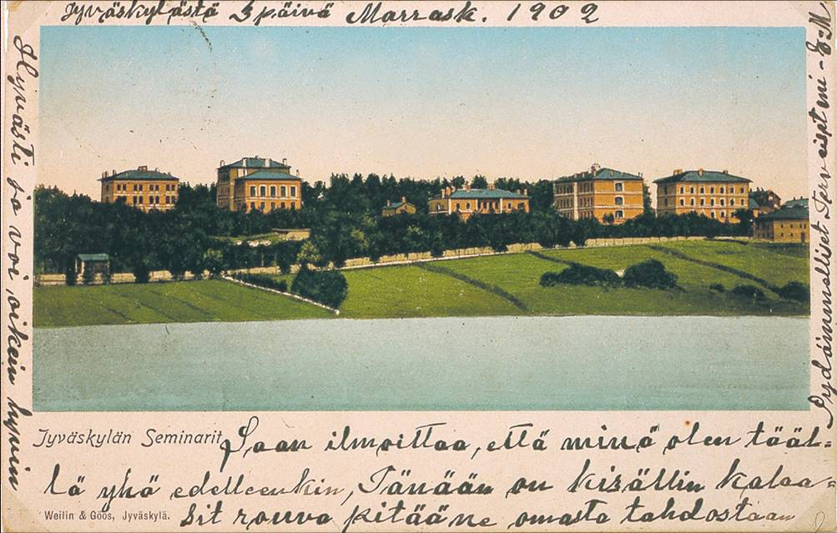
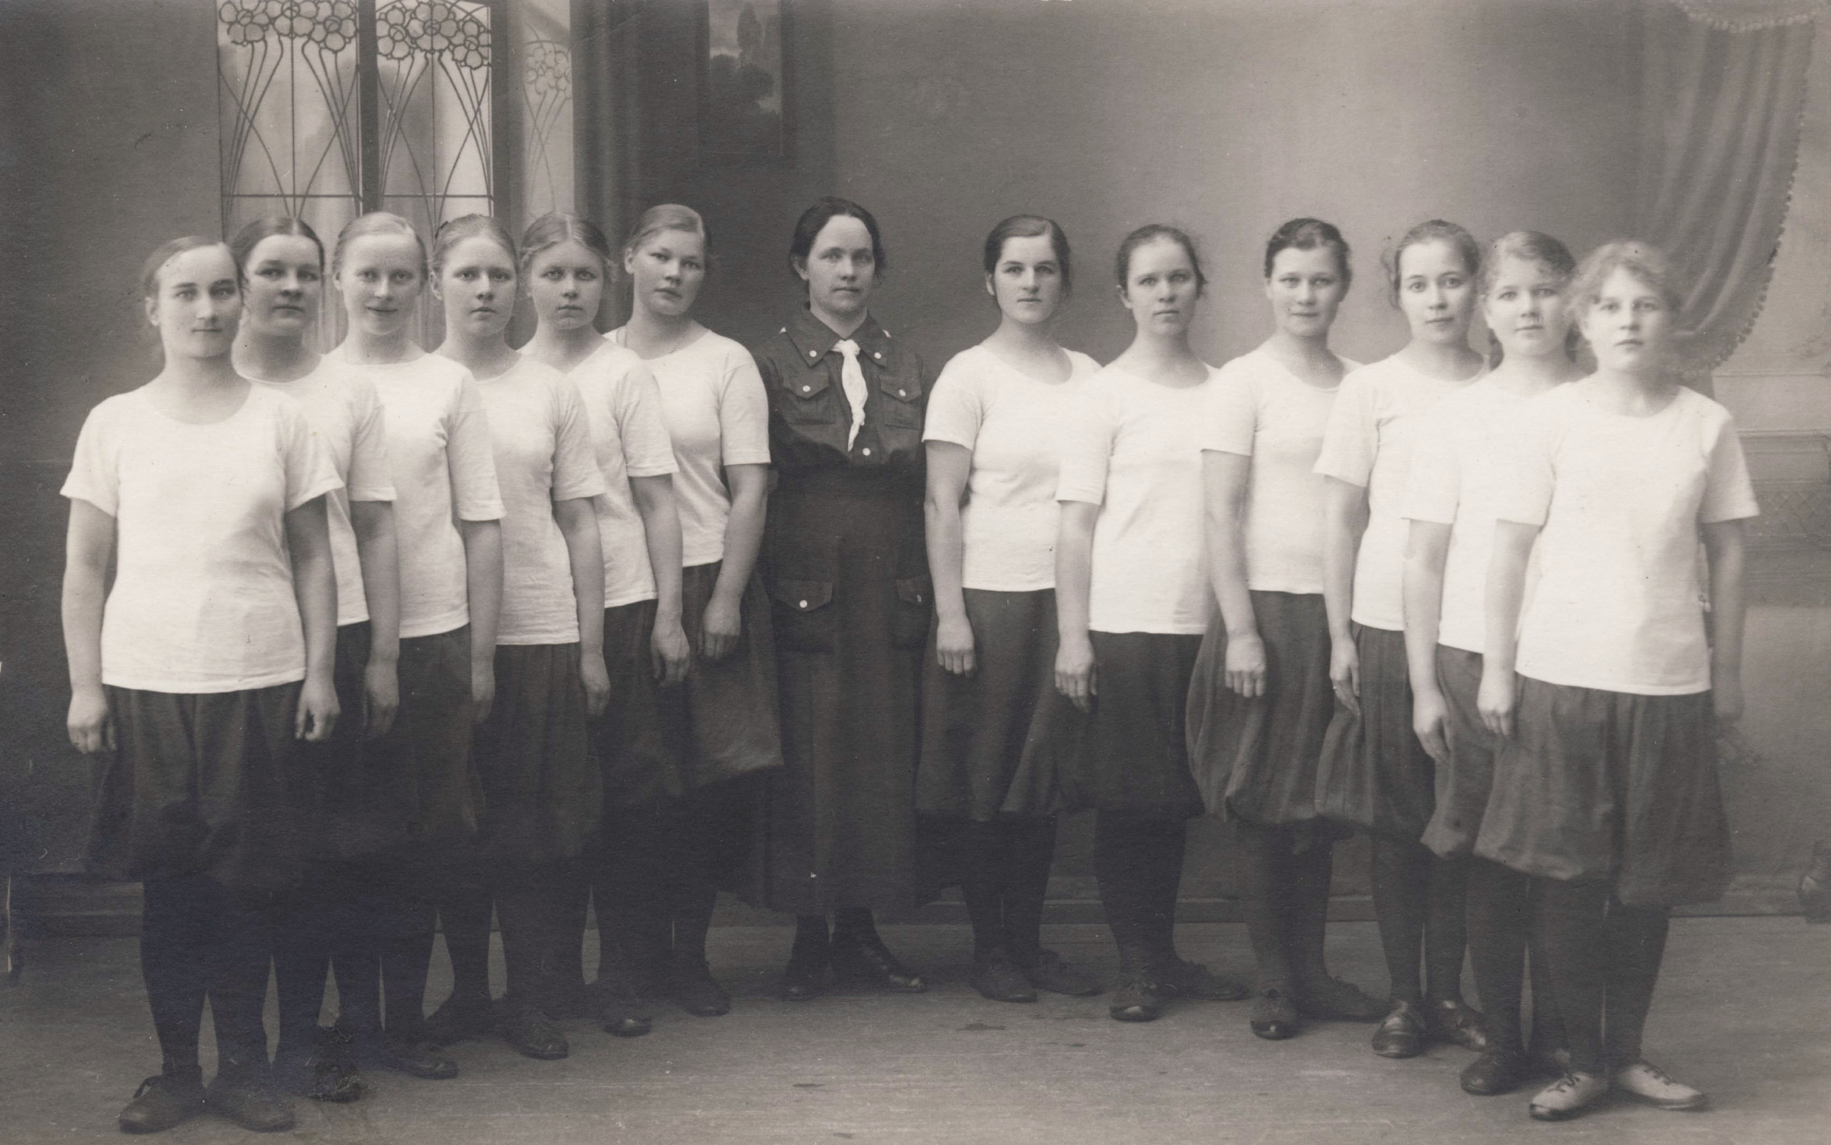
From teacher seminary to multidisciplinary university
1863
1879–1883
1934
Uno Cygnaeus establishes in Jyväskylä the first Finnish-language teacher seminary for men and women
The first buildings of the Teacher Seminary are built in the area that later becomes known as the Seminaarinmäki campus
The Seminary becomes the Jyväskylä College of Education
1955
1958
1963
The University Main Building designed by Alvar Aalto is completed
The establishment of the Faculty of Philosophy and professorships of humanities directs the college’s development towards university status
Physical education teacher training starts
1966
1980s
2022
The University of Jyväskylä opens its doors
The University’s expands to new campuses in Mattilanniemi and Ylistönrinne
Finland’s first European Cultural Heritage Label is awarded to the Seminaarinmäki campus and the university’s role in promoting equality through education

Slide 14
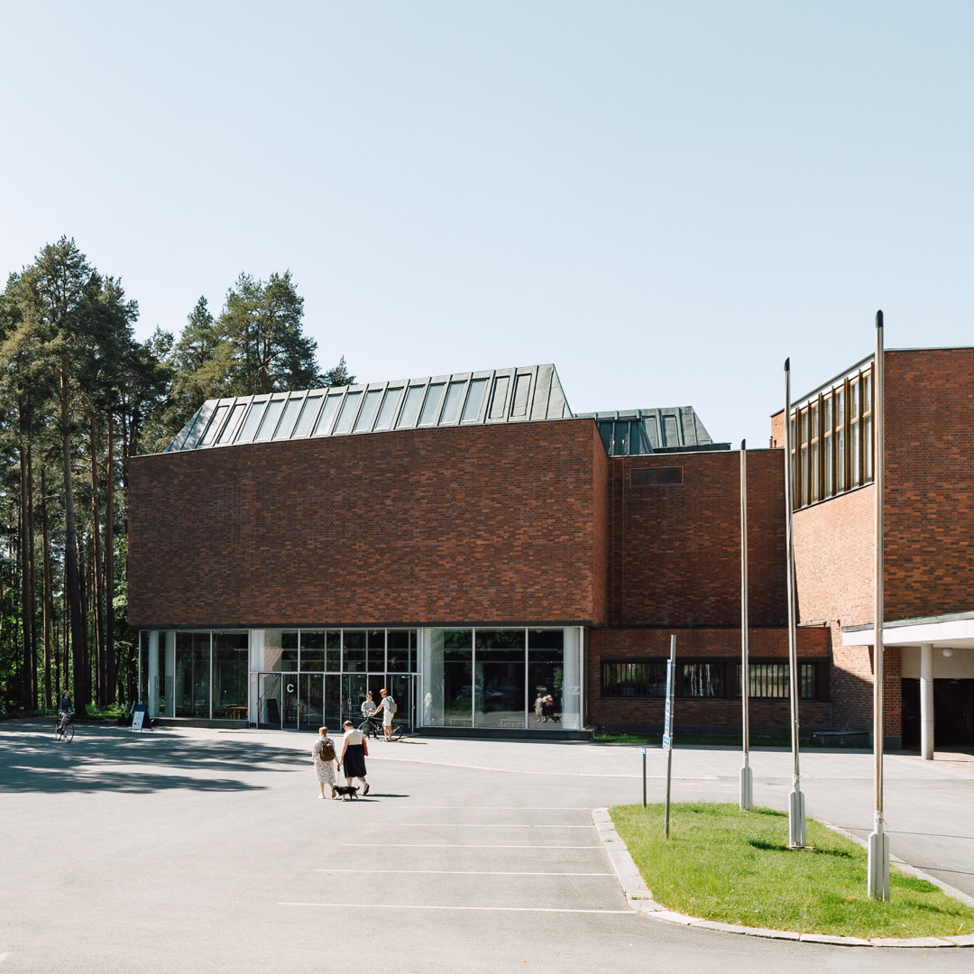
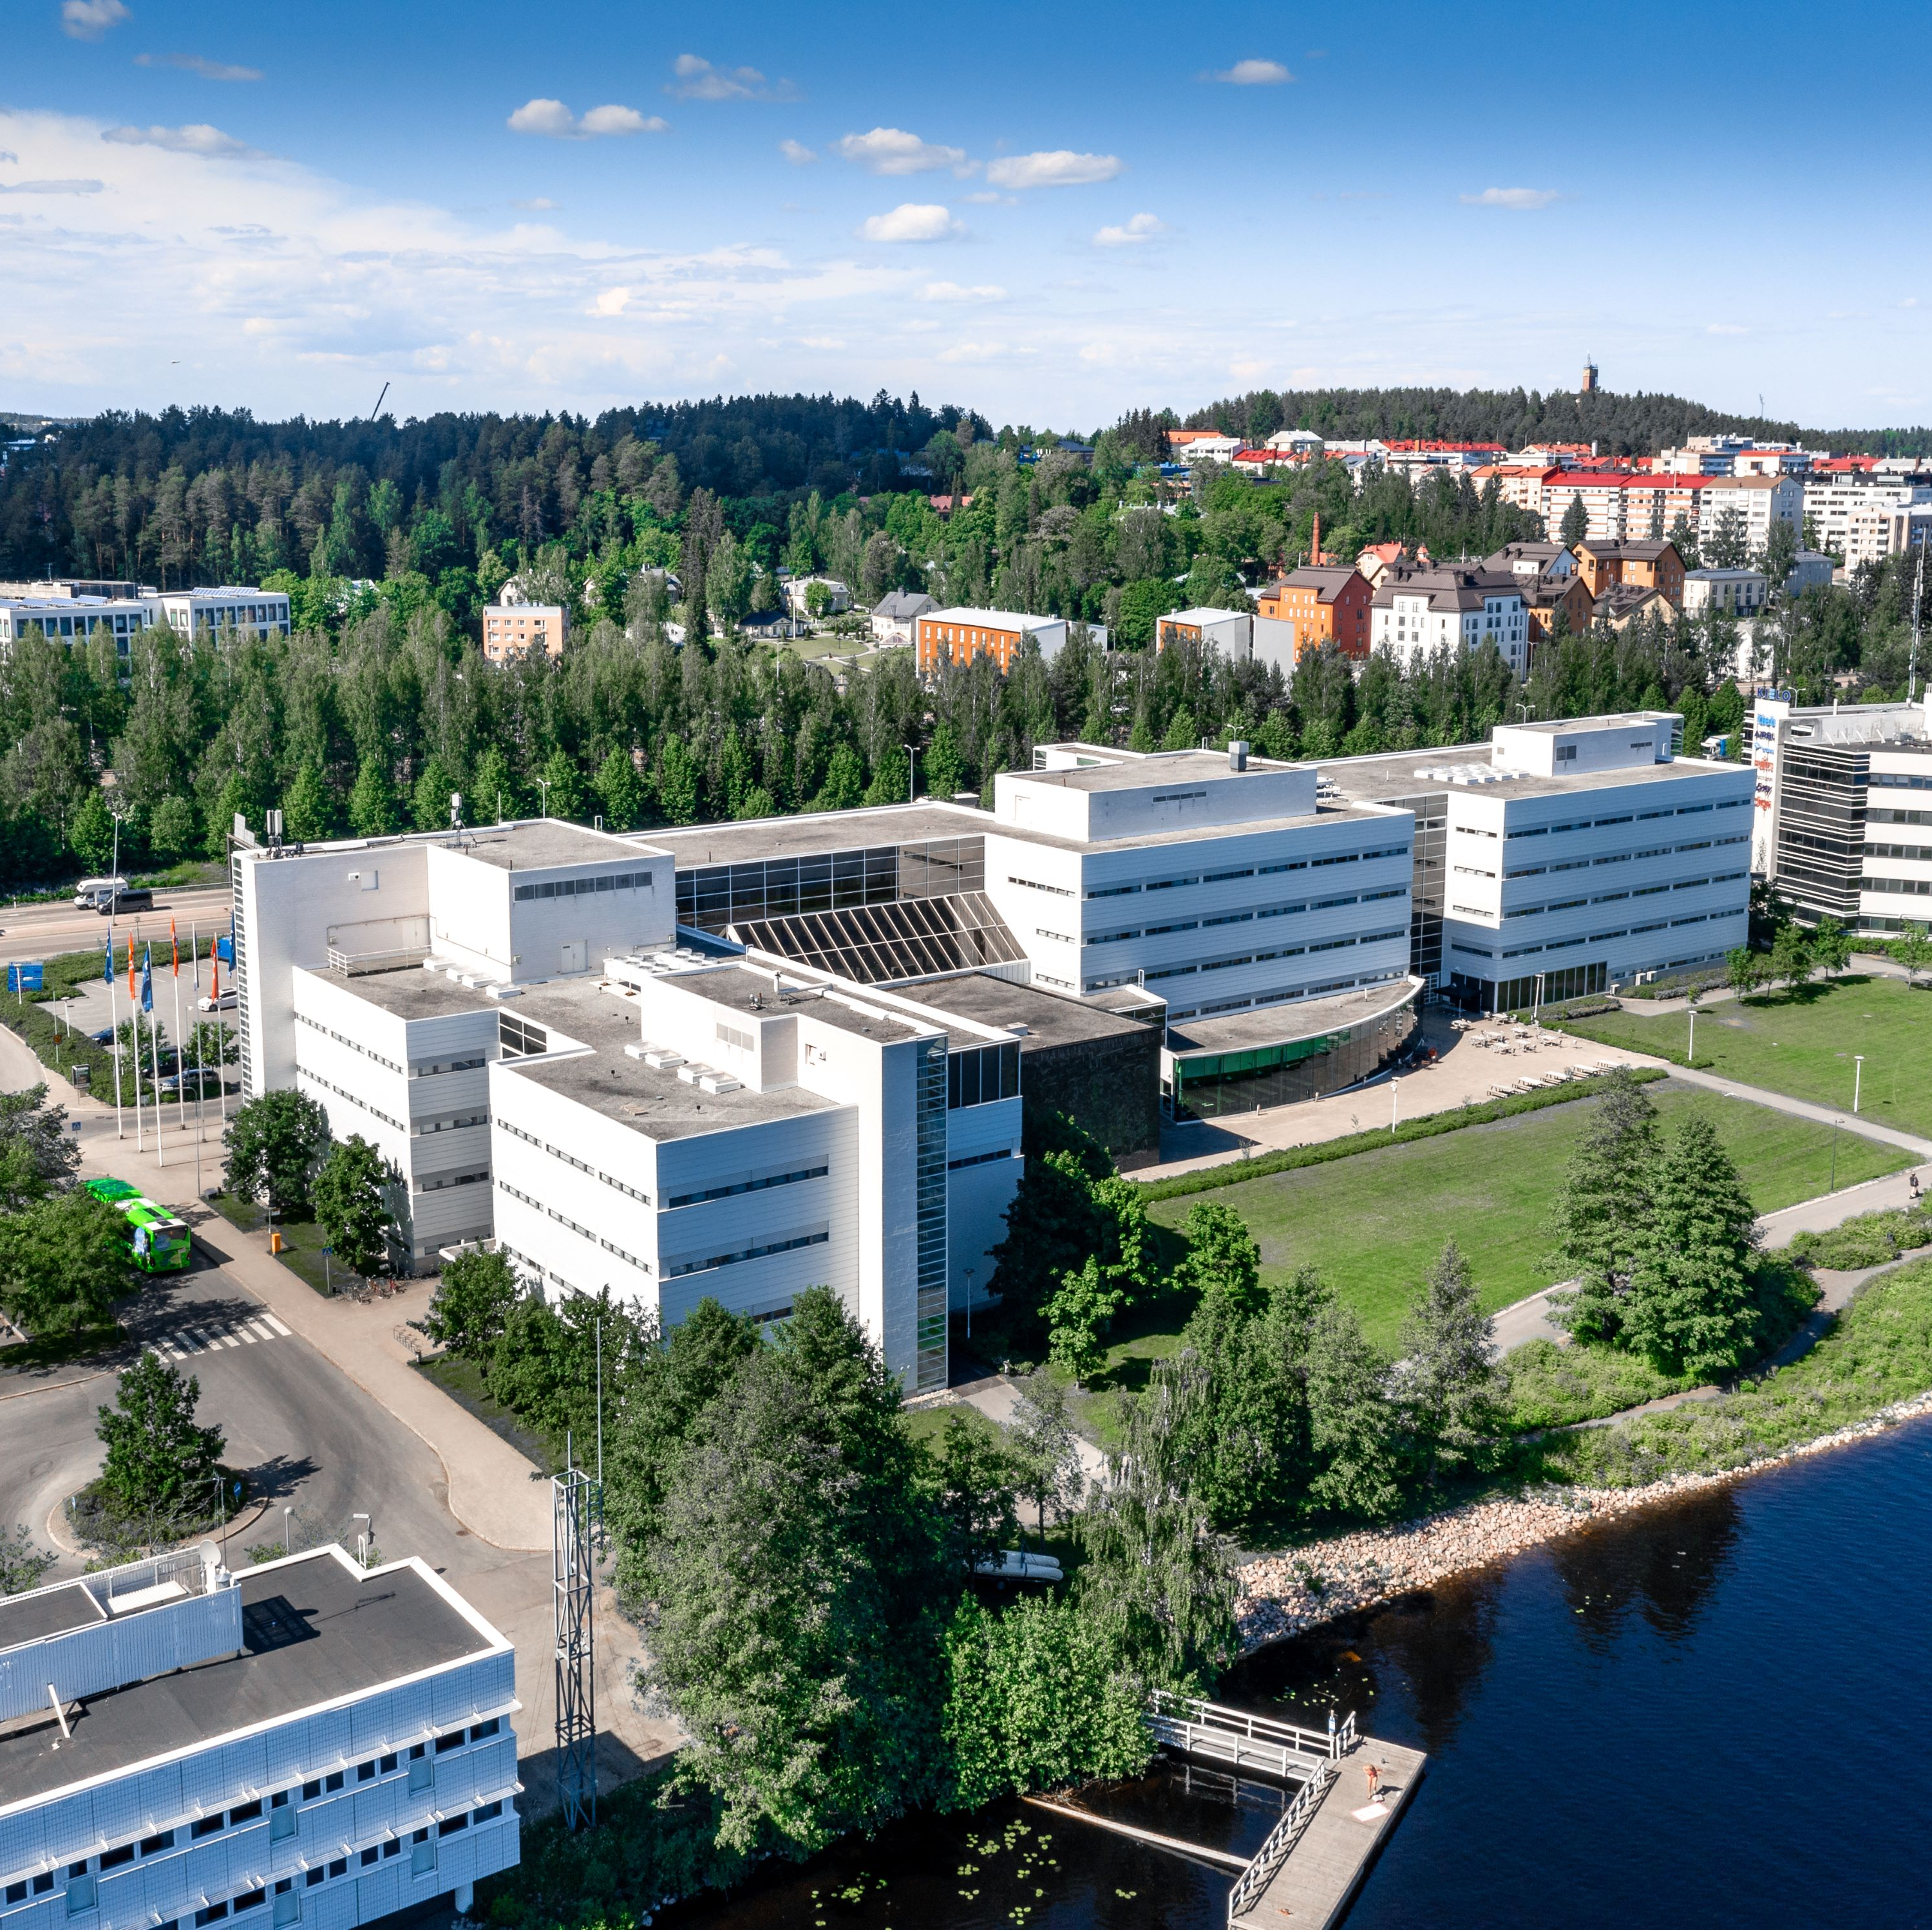
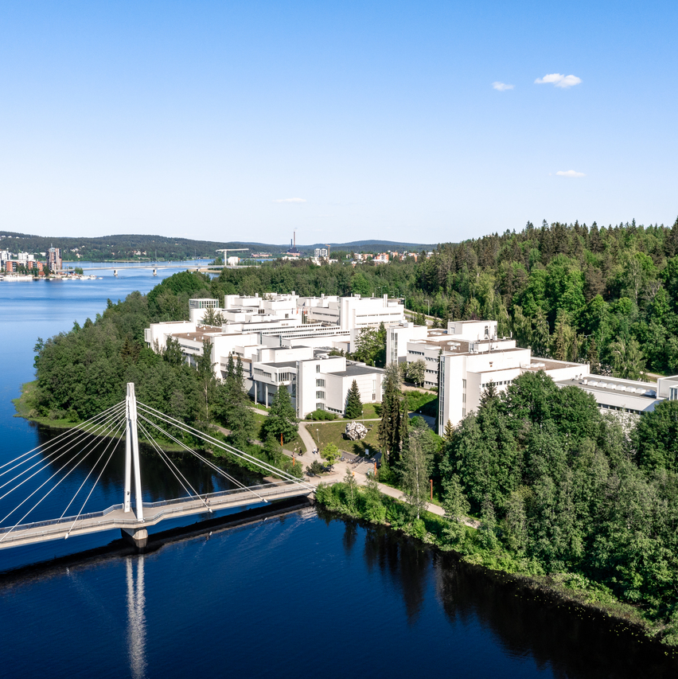
Campuses
Seminaarinmäki
Mattilanniemi
Ylistönrinne

Slide 15
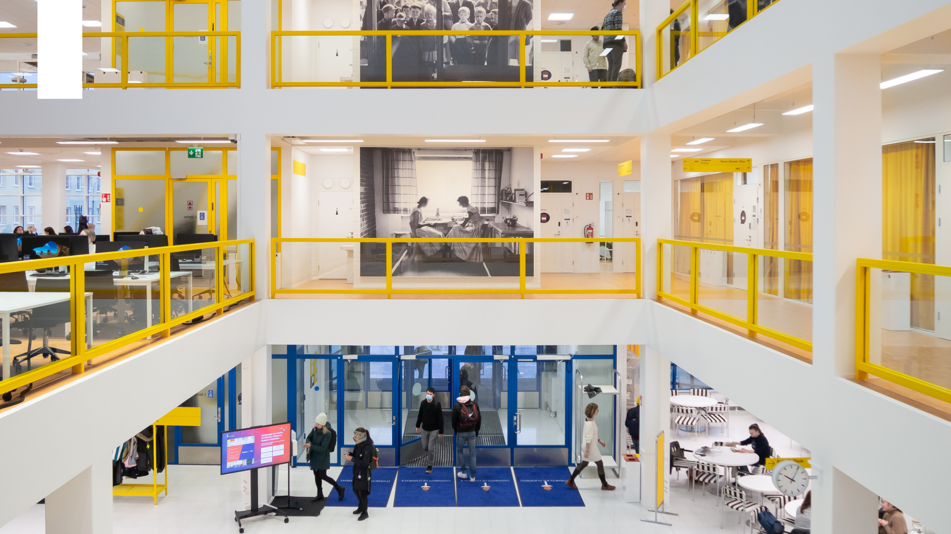

European Cultural Heritage Label and Finlandia Prize for Architecture 2022
In April 2022, the University’s Seminaarinmäki campus was the first site in Finland to receive the European Cultural Heritage Label (ECHL). The campus highlights the significance of the Finnish and European education system as a basis for equal and democratic society.
The campus features buildings designed by Alvar Aalto and Arto Sipinen. In 2022, the comprehensive renovation of the University Library Building Lähde received the Finlandia Prize for Architecture.

Slide 16
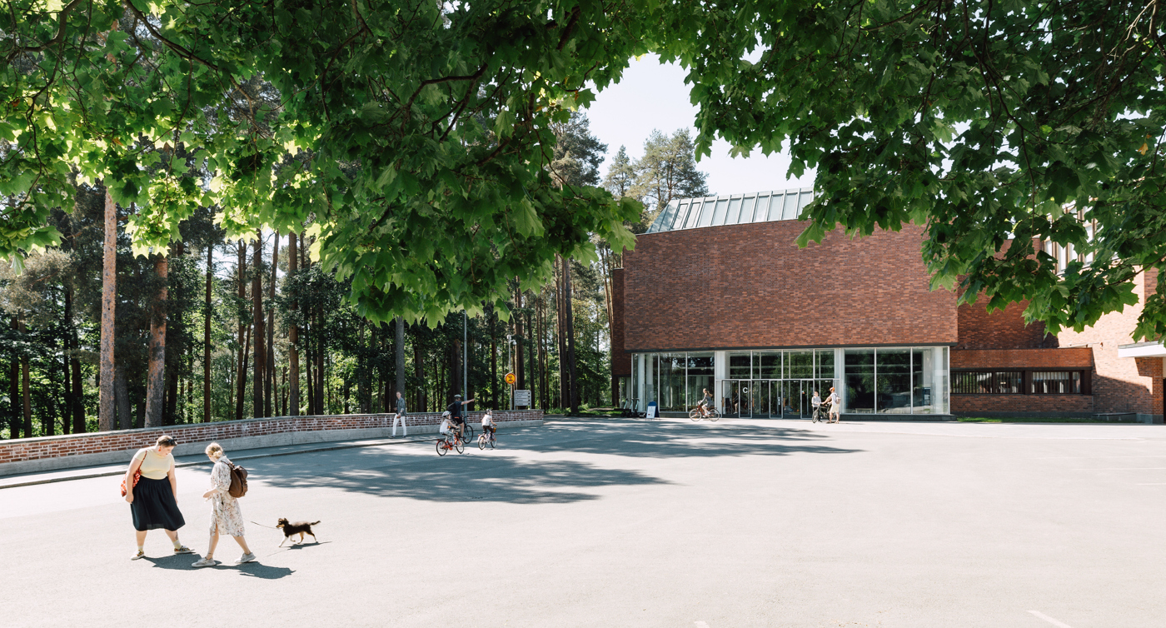
Key figures
6 faculties
5 independent institutes
14,600
degree students
2,800 staff in total
€232 m overall funding
Supplementary funding €80.7 m
3,200
publications annually
1,700
teaching and research staff

Slide 17
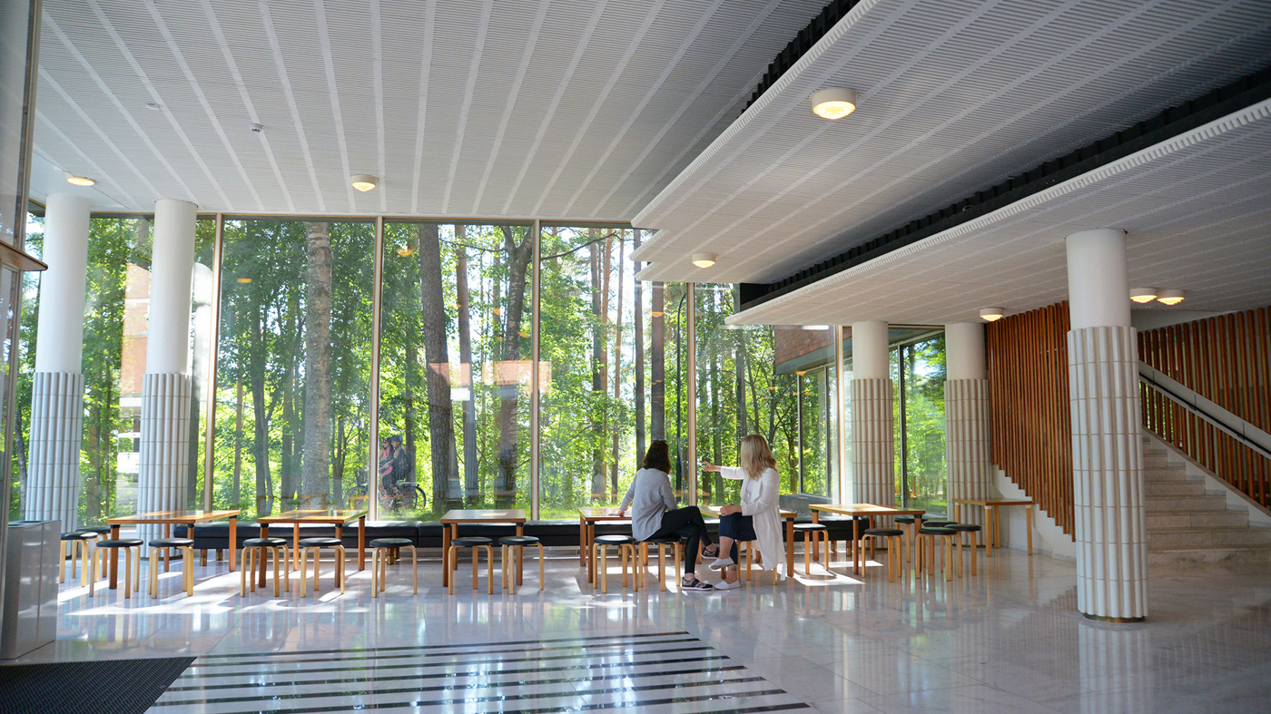
Jyväskylän yliopisto on Suomen suurimpia ja monialaisimpia tiedeyliopistoja.
JYU:ssa opiskelija valitsee yli sadasta oppiaineesta ja yhdistelee itsensä näköisen poikkitieteellisen tutkinnon.
134
bachelor’s and master’s degree programmes in Finnish
21
bachelor’s and master’s degree programmes in English
18
doctoral programmes

Slide 18
Organisational structure
University Collegium
Chair Tommi Kärkkäinen
University Board
Chair Antti Koivula
Rector and
Vice Rectors
Rector
Jari Ojala
Education
Marja-Leena Laakso
Research
Kaisa Miettinen
Societal interaction
Pasi Raiskinmäki
Humanities and Social Sciences
Mika Lähteenmäki
Information Technology
Pasi Tyrväinen
School of Business and Economics
Vilma Luoma-Aho
Education and Psychology
Marja-Kristiina Lerkkanen
Sport and Health Sciences
Vesa Linnamo
Mathematics and Science
Timo Sajavaara
JYU Open University
Jukka Lerkkanen
Open Science Centre
Acting Managers
Arto Ikonen and Johanna Kinnunen
Centre for Multilingual Academic Communication (Movi)
Peppi Taalas
Kokkola University Consortium Chydenius
Marko Aittola
Finnish Institute for Educational Research
Taina Saarinen
University Services
Päivi Seppä

Slide 19
Student and Academic Services organisation 16.2.2026
Student and Academic Services, Director of Student and Academic Services Mari Ikonen
Digitalisation of Education Services Riikka Hurri
Support for Education Governance and Development
Kaisa Lällä
Services for Education Planning and Implementation
Maija Pöyhönen
Services for Internationalization in Education
Heta Koski
Services for Student Admissions and Doctoral Education
Tiina Hemminki
Study Services
Elina Ratalahti
Education Governance Support
Marja Korhonen
Education Specialist Services Kivi, Movi
Tiina Suominen
International Office
Auli Pitkänen (12 persons)
Admission Services
Maria Kotiranta
Student Service Desk
Mirve Pynnönen
Education Development Support
Leena Penttinen
Education Specialist Services Hela, Mutku, YFI
Anna-Mari Järvinen
Support Services for Internationalisation
Riikka Vanhanen (8 persons)
International Admissions
Emilia Tolvanen
Continuous Learning Services
Riikka Perämäki (Vilma Virtanen)
Education Specialist Services KPTK
Tiina Nyyssönen
Statistics Advisory
Support for Doctoral Sudies
Heli Niskanen
Degree Education Services
Joachim Kratochvil
Approximately 145 professionals and experts in study administration and education development work in Student and Academic Services.
Education Specialist Services ITK, JSBE
Jaana Markkanen
Education Specialist Services LTK, MLTK
Minttu Haapaniemi

Slide 20
Open and ethically high-quality research with societal impact – the Strategy of JYU

Slide 21

Internationally attractive university
Key strategic objectives
An internationally renowned, high-quality degree programme portfolio
A first-class student experience for everyone
The best employer among universities in Finland: an inspiring university for creativity and growth with a strong community spirit.

Slide 22
Strategy and the development of international education
The strategy refers to internationalisation of education in many ways
  More international degree programmes
  More international degree students and staff
In late 2024 JYU set new targets for the amount of international degree students (together with the Finnish Ministry of Education)
  Goal was to increase the percentage of intl degree students (including bachelor, master and doctoral students) from 4.8% to 12% by 2028
  Today we know that the numbers have not increased in this way, so it will be very difficult to reach the goal
  A big number of Finnish students apply to our interational programmes
A two-year project to develop the international degree programme portfolio and the programmes
JYU very interested in starting new international joint/double degree programmes with partners to increase the international offer and the number of international students
Currently in JYU:
2 international Bachelor degree programmes
20 international Master degree programmes
2 Erasmus Mundus programmes (as a partner)
Plans for joint/double degree programmes

Slide 23

Aims for international mobility & educational cooperation
All students (irrespective of field) develop their internationalization skills during their studies through mobility, training and internationalization at home (internatiolisation plan)
Well-planned & high quality international student and staff mobilities
Staff mobility facilitates professional development, exchange of good practices and joint development of educational programmes
Strongly increasing number of international degree students, who are well integrated to JYU and to the surrounding society
Closer cooperation with selected partner HEIs rather than increased number of agreements
Involving all units in FORTHEM activities
Some strategic priorities, e.g. cooperation with Japan (city of Jyväskylä, Toyota, Central Finland Mobility Foundation)

Slide 24

International partnerships
Some 60 JYU-level MoU’s and exchange agreements mostly with non-EU HEIs
Field-specific Erasmus exchange agreements (IIA’s) with some 280 HEIs, including Erasmus mobility (ICM) with partner countries
Participation in NORDPLUS and ISEP mobility programmes
Cotutelle agreements
Two Mundus Master’s programmes: RADMEP and NeuroData
JYU membership in European University Network FORTHEM: institutional strategic partnership (https://www.forthem-alliance.eu/)

Slide 25

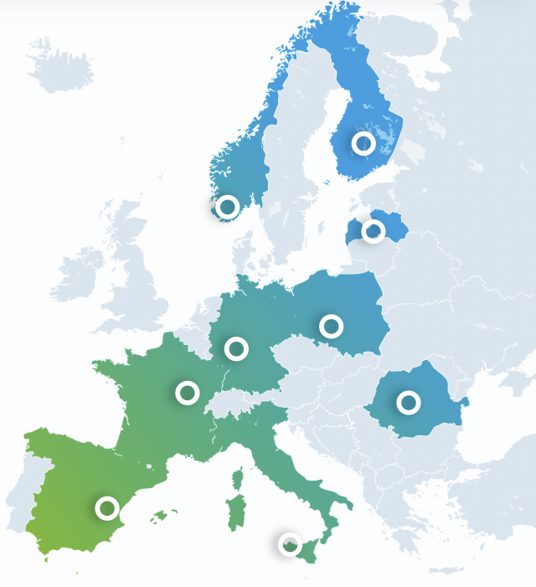

Pilot phase in Sept 2019 – Oct 2022 with 7 members
Jyväskylän yliopisto
Universitetet i Agder
Continuation phase from Nov 2022 onwards with 9 members
Latvijas Universitate
Johannes Gutenberg-Universität Mainz
FORTHEM NEXUS application for 2027-2028:
Information of the funding to be expected in July 2026
If the funding decision in positive, JYU will be leading the two-year funding period
Uniwersytet Opolski
Université de Bourgogne
Universitatea Lucian Blaga din Sibiu
Universitat de València
Università degli Studi di Palermo

Slide 26
JYU student mobilities in 2023-2025

Slide 27

Services for international students
Pre-arrival support, orientation programme
Peer-to-peer student tutoring service​
Student restaurants on campus​
Libraries with workstations and meeting zones
Academic English and Finnish language courses​
University sports services​ uMove
Student Life - Wellbeing Support for Students
Local friendship programme (for degree students)
Internationalization opportunities incl. international mobility​
Career support, internship voucher​ (for degree-seeking students)
Alumni study right (for degree-seeking students)

Slide 28
Thank you:
- for participating in this Staff week!
- for working together with us to build bridges and to create a better world for all of us!

Slide 29
@uniofjyvaskyla
jyu.fi

