Slide 1
Sharing and creating good practices to plan and implement joint and double degree programmes in universities
International Staff Week 8-12 June 2026
Track 3

Slide 2

Welcome to the track 3!
Track hosts from the JYU’s Student and Academic Services
  Riikka Vanhanen
    Project Manager, Structural Development of International Degree Programmes and Team Leader, Support Services for Internationalisation
  Elisa Heimovaara
    International Coordinator, Faculty of Education and Psychology
  Emilia Ahvenjärvi
    Head of Student and Academic Affairs, Faculty of Sport and Health Sciences
The hosts’ role is to facilitate the joint learning process
  The content is created together!

Slide 3
Track schedule
Wednesday 10 June
Thursday 11 June
10.00-12.00 Planning (Riikka)
  Joint degree development at JYU
    Enabling structures for establishing joint and double degrees
  Where are you at?
  Group work
12.00-13.30 Lunch break
13.30-15.00 Sharing
  Sharing the best practices for establishing international joint and double degrees
10.00-12.00: Implementation (Elisa)
  From planning to implementation
    Curriculum, mobility, agreements etc. in practice
  Group work
12.00-13.30 Lunch break
13.30-15.30: Future (Emilia)
  What does the future look like for international joint degree programmes?
    European Degree Label & European Approach for Quality Assurance –global attractiveness of European degree programmes

Slide 4

Session 1:
Planning
Best practices for establishing international joint and double degree programmes

Slide 5
Track background: International joint degree programmes at JYU –where are we at?
JYU strategy -strong emphasis on internationalisation
  Among other objectives, a reference to significantly increasing the number of international joint degree programmes
  Means to enhance internationalisation; contributes to the wider work on managing JYU’s degree programme portfolio; attracts more international degree students (not the only strategy though)
Two Erasmus Mundus Joint Master’s Degree Programmes
  Master's Degree Programme in Radiation and its Effects on MicroElectronics and Photonics Technologies (RADMEP+)
  Master's Degree Programme in Brain and Data Science (NeuroData)
Also Erasmus Mundus Design Measures funding for one programme and several negotiations on international joint and double degrees
“Learning by doing”
Need for systematic management of information, defining of processes and division of work
  Process description for planning and implementing an Erasmus Mundus joint programme: who does what and when?
  Current process: updating and complementing the guidelines for international joint and double degrees (by the end of the year)

Slide 6
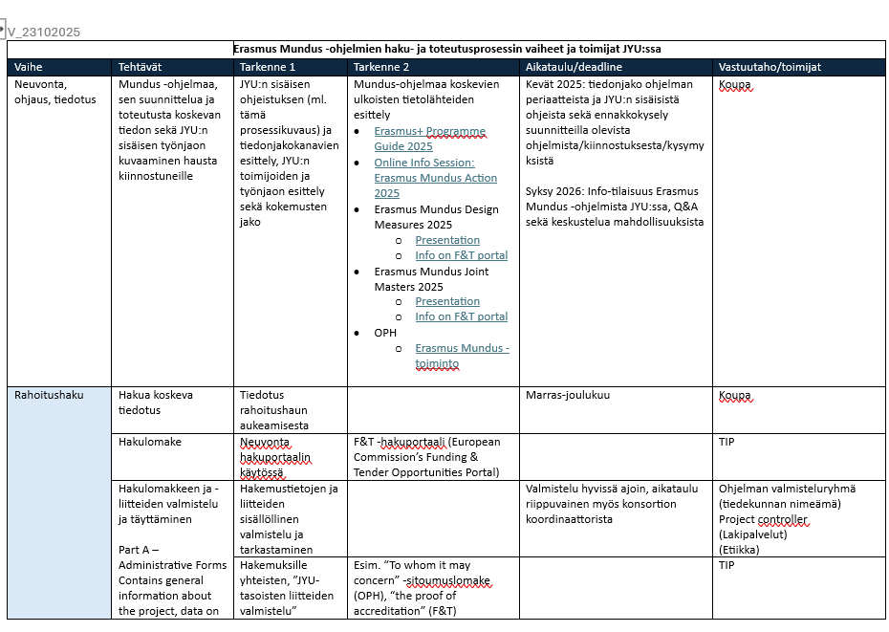
Tools to support the planning and implementation of international joint and double degrees
Application for funding and implementation of an Erasmus Mundus programme: Stages of the process and division of work at JYU
JYU Guidelines for international joint and double degree programmes
The 2022 version to be updated and complemented with new information
  Defining the concepts of “joint” and “double” degrees
  Updating the “why” –the importance of the joint degrees for the university
  Acknowledging the changes in the law regarding the tuition fees
  National guidelines
  Admissions process, mobility schemes and funding
  Curriculum, study and teaching modes
  Planning process, responsibilities and decision making
  Sustainability
  Etc.

Slide 7
Where are you at?
Where does your institution/programme stand & what is your role/experience with regard to joint international degrees?
Beginner: Interested/just getting started
Intermediate: Some experience in planning and/or implementing
Expert: Experience in running and developing

Slide 8
Forming small work groups with a mix of representatives from each stage/category
Beginner: Interested/just getting started
Intermediate: Some experience in planning and/or implementing
Expert: Experience in running and developing

Slide 9
What’s crucial at the initial stage: tracking the best practices for solid premises of cooperation
Task for the group work: Create a check list (max. 10 points) for the most important things to consider at the planning stage of international joint/double degrees.
The lists will be presented to others in the afternoon session starting at 13.30.
You can use the flip charts and other material provided.
You can also work outside/in another room/ over lunch –as long as you’re back at D109 at 13.30.

Slide 10
Possible questions and perspectives to consider “administrative wise”
How to choose partners for the programme/ consortia?
What are the biggest possible problems or bottlenecks to consider?
Joint or double?
What is the HEI’s/ programme’s incentive to establish the joint programme?
What is the admissions process?
National and legal framework: how do they support?
The economics? How is the programme financed? Is it sustainable?
What’s the added value of the joint programme to the HEI/programme/student?
What kind of support is needed institutionally to establish a joint programme?
Who are the potential students/ target group?
Support services and staff needed for the programme? Is the division of work clear?
Questions regarding immigration, student’s living costs etc., academic culture
Plans for marketing and recruitment?

Slide 11

And what about all the rest beyond the “bureaucracy”?

Slide 12

Session 2:
Sharing
Sharing best practices

Slide 13

Presenting the group work (15 mins. each)
What kind of elements form a solid basis for planning an international joint/double degree?

Slide 14
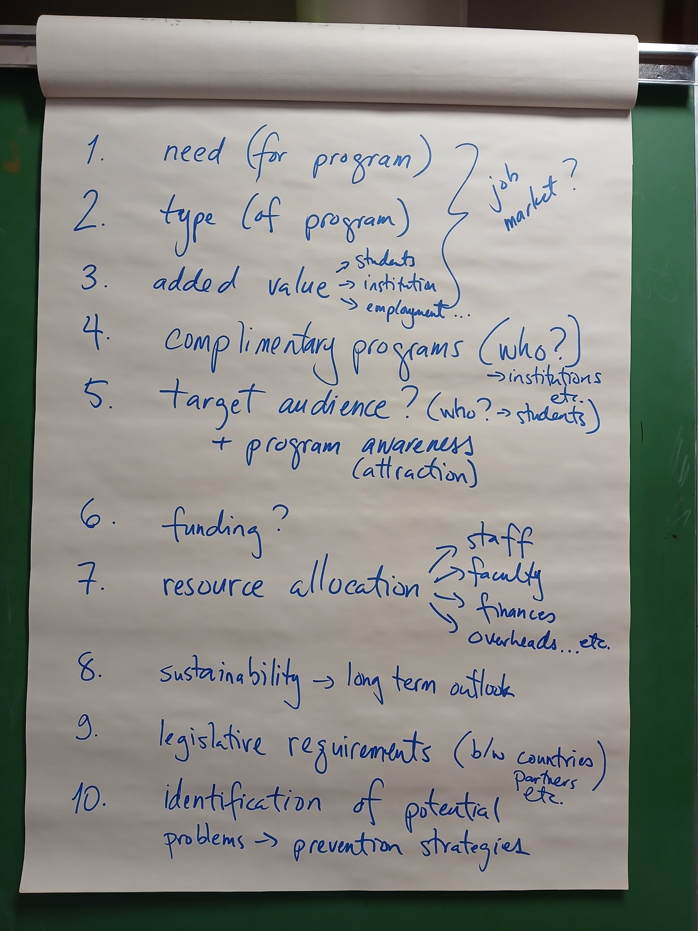
Group 1

Slide 15
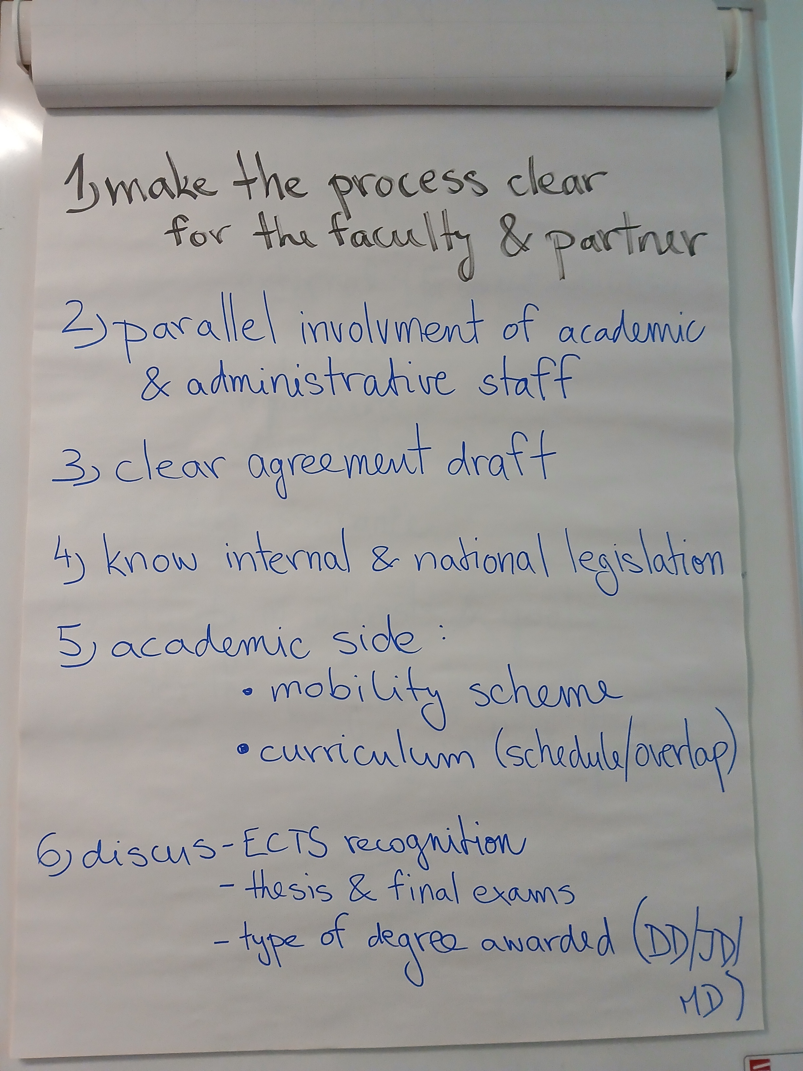
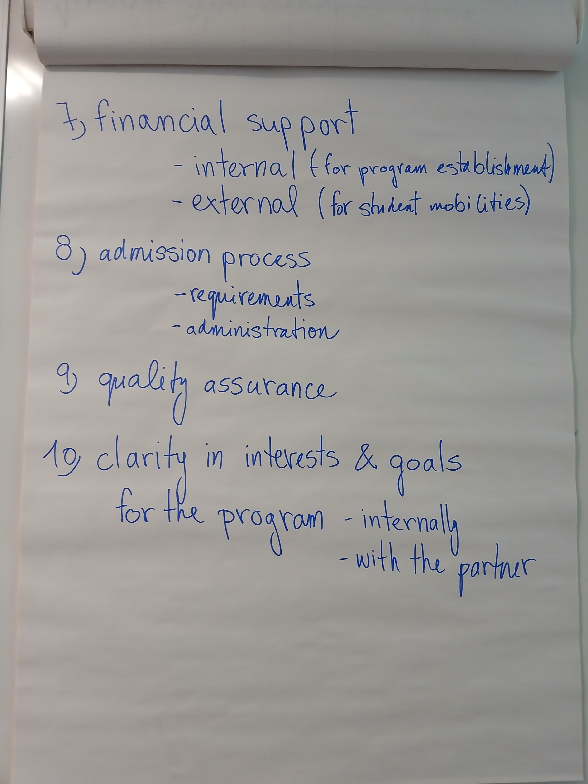
Group 2

Slide 16
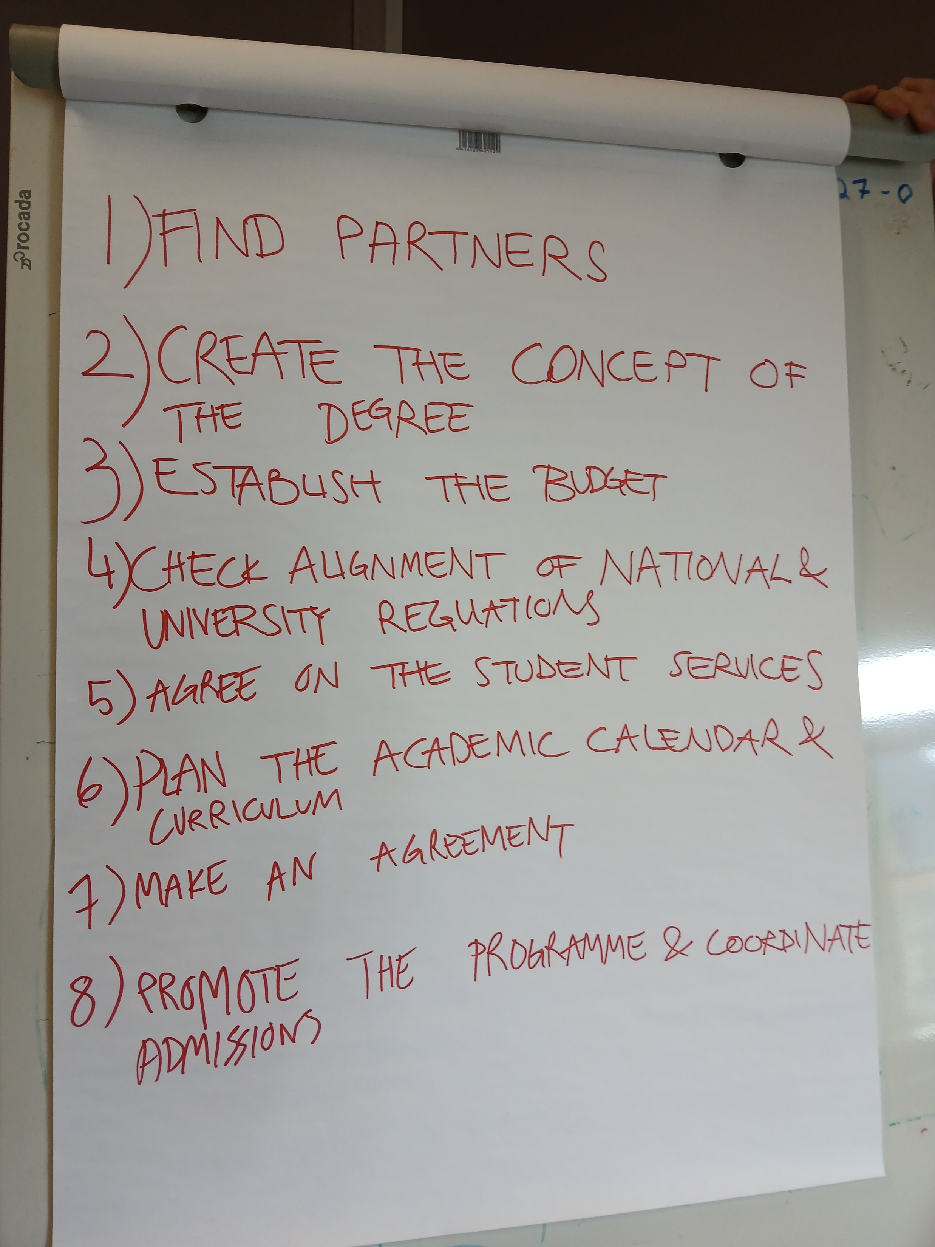
Group 3

Slide 17
Discussion and closing the day 1 of the track 3
What did you learn?
What do you expect from tomorrow?

