Slide 1

Session 3:
Implementation

Slide 2

Theme groups and questions to discuss
- summarise on flip board
1. Curriculum development and teaching practices, administrative processes
credit equivalence, grading
requirements examinations and proving competence
supervision practices
Thesis
Academic fraud?
Distance teaching/learning
2. Admissions process
Separate or Joint?
Admissions criteria (e.g. language requirements)
Informing students
National requirements
Entry to countries

Slide 3
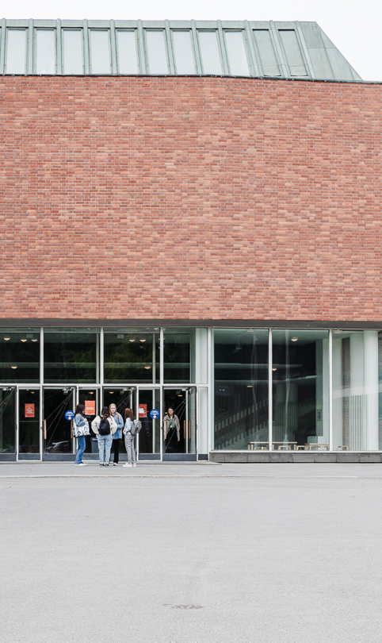
Theme groups and questions to discuss
- summarise on flip board
3. Mobility schemes
Mobility funding and possibilities: best practices, ethics
Erasmus funding, university budget, other sources
Compulsory, voluntary
4. Agreements & risk management, contingency
Continuity from student perspective
Withdrawal of a partner (e.g. geopolitical issues or strategic decisions within an organisation)
Immaterial rights
Student expectations

Slide 4
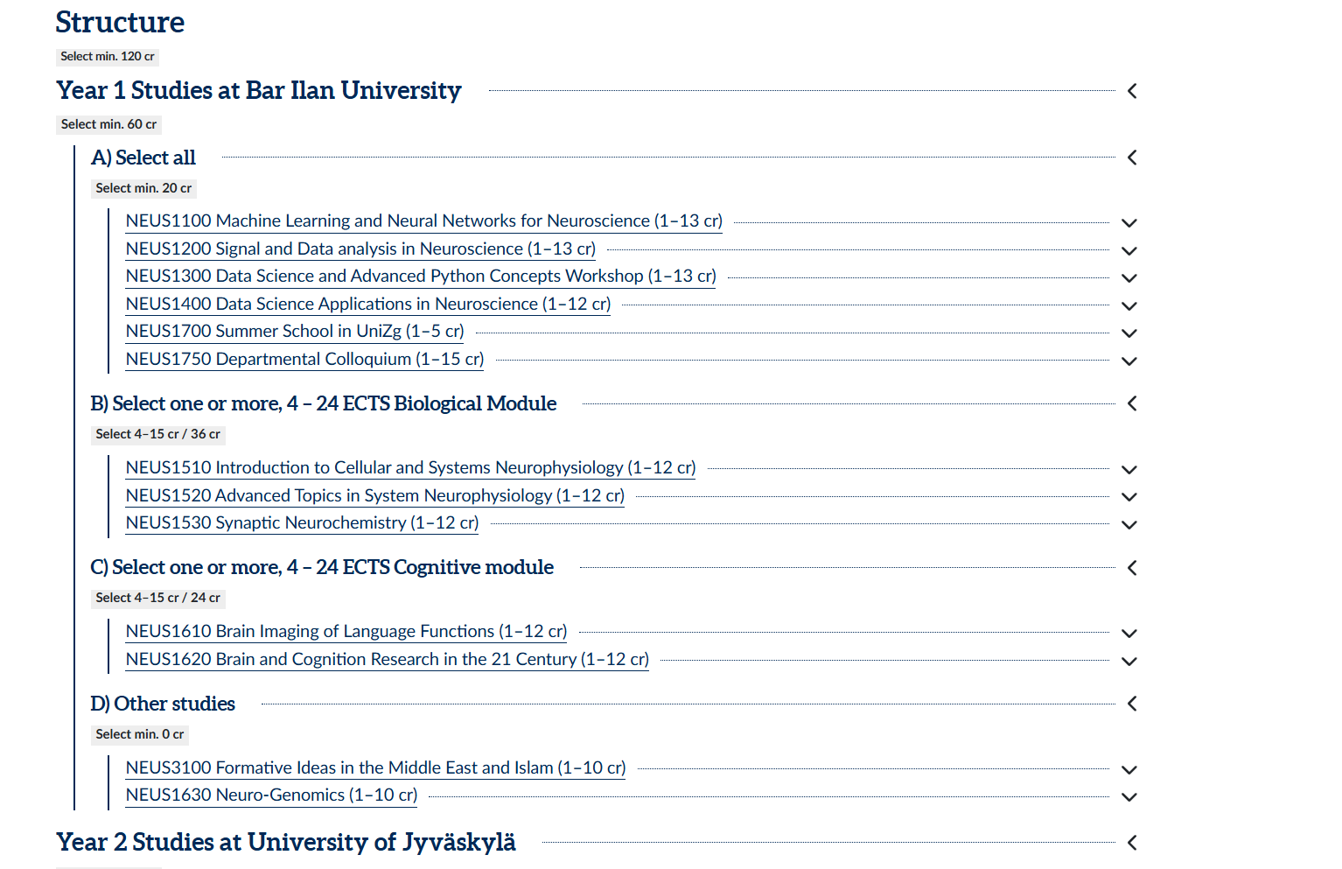

Slide 5
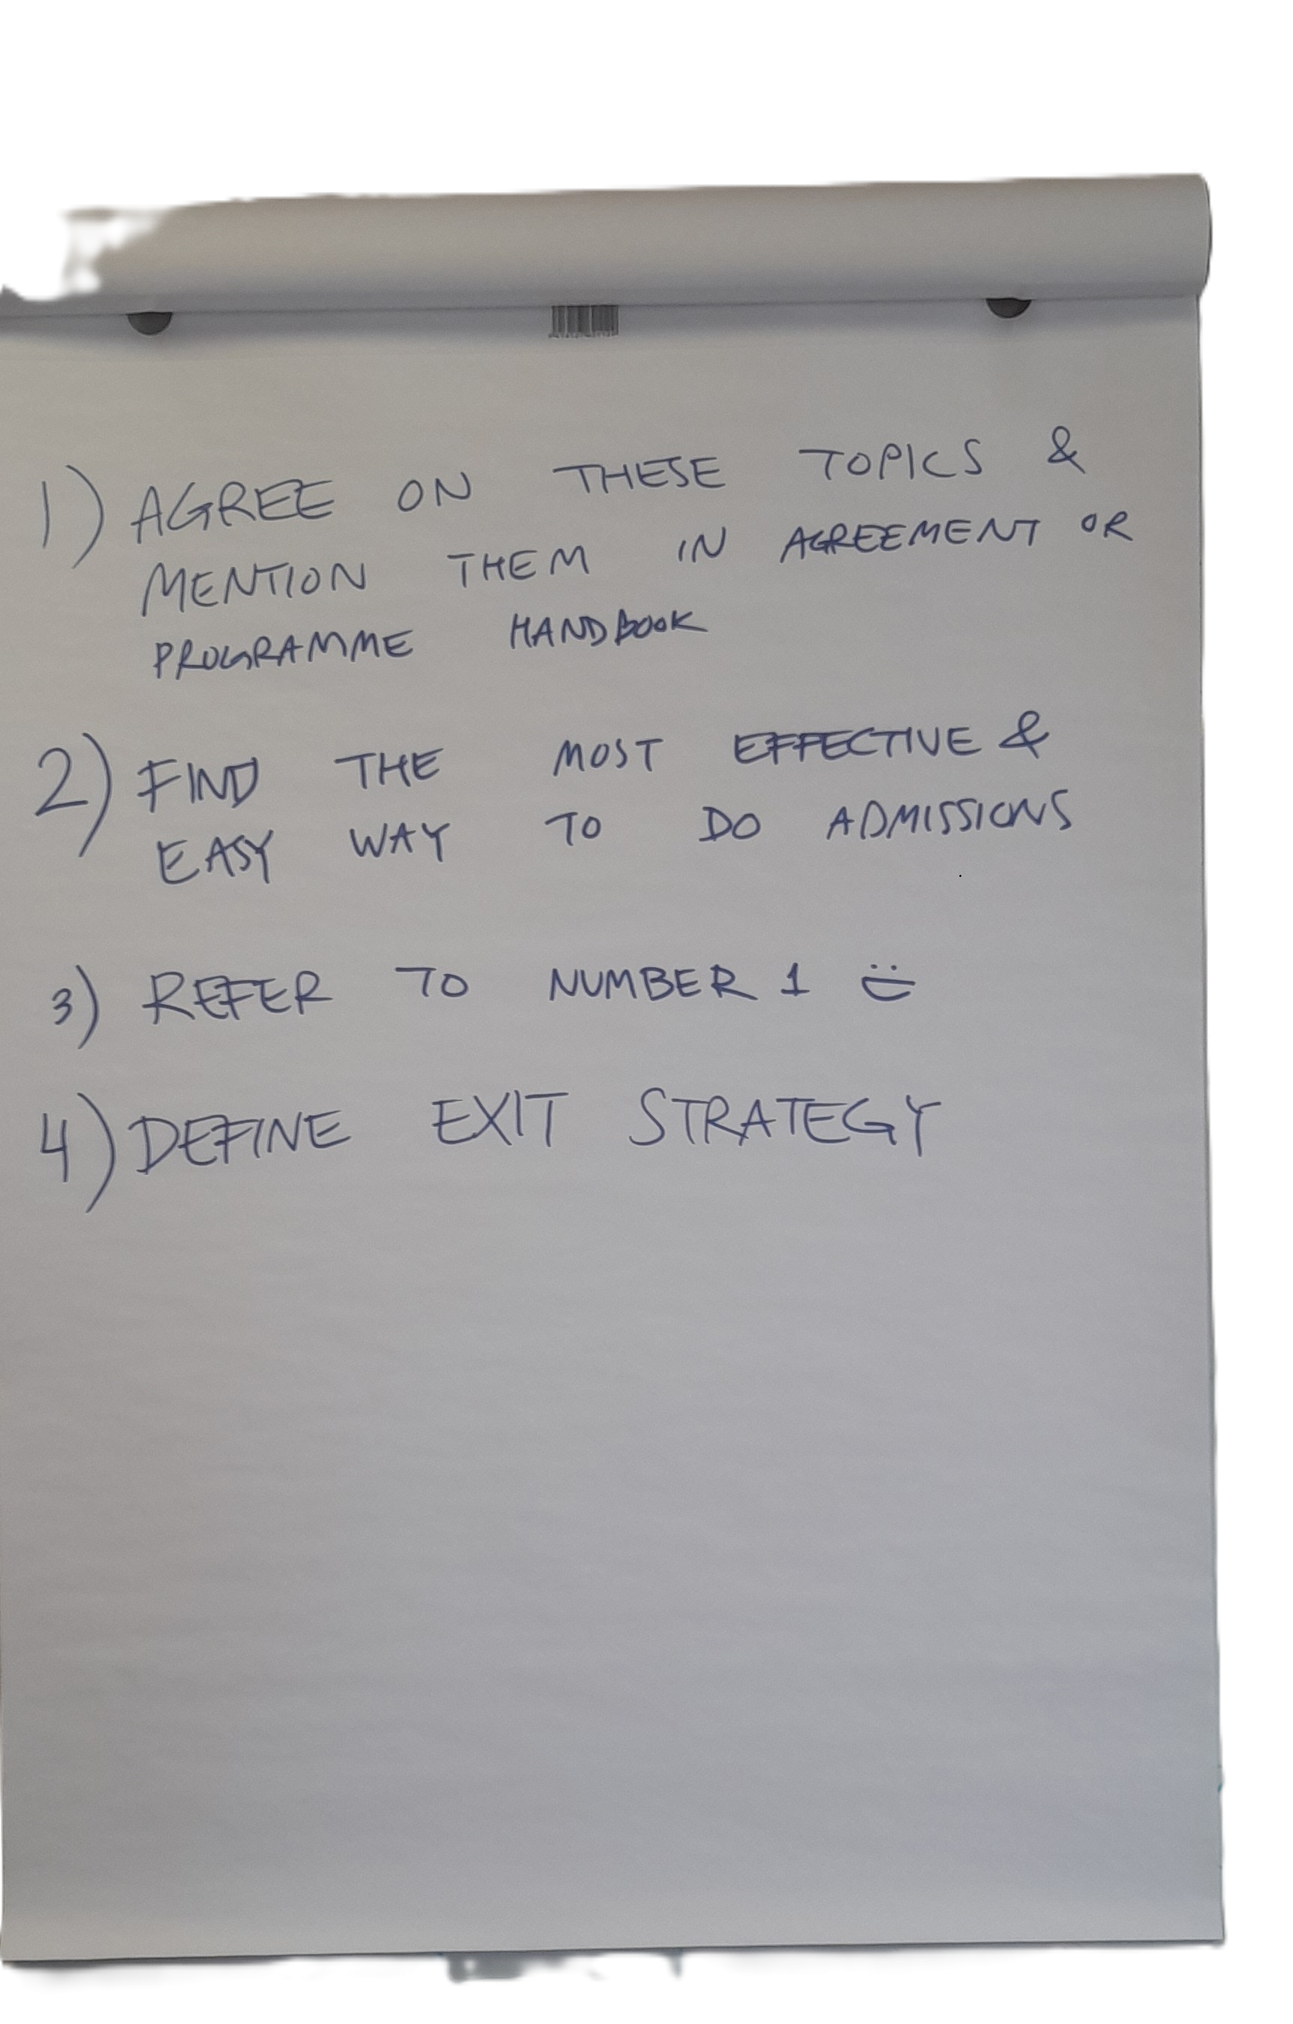
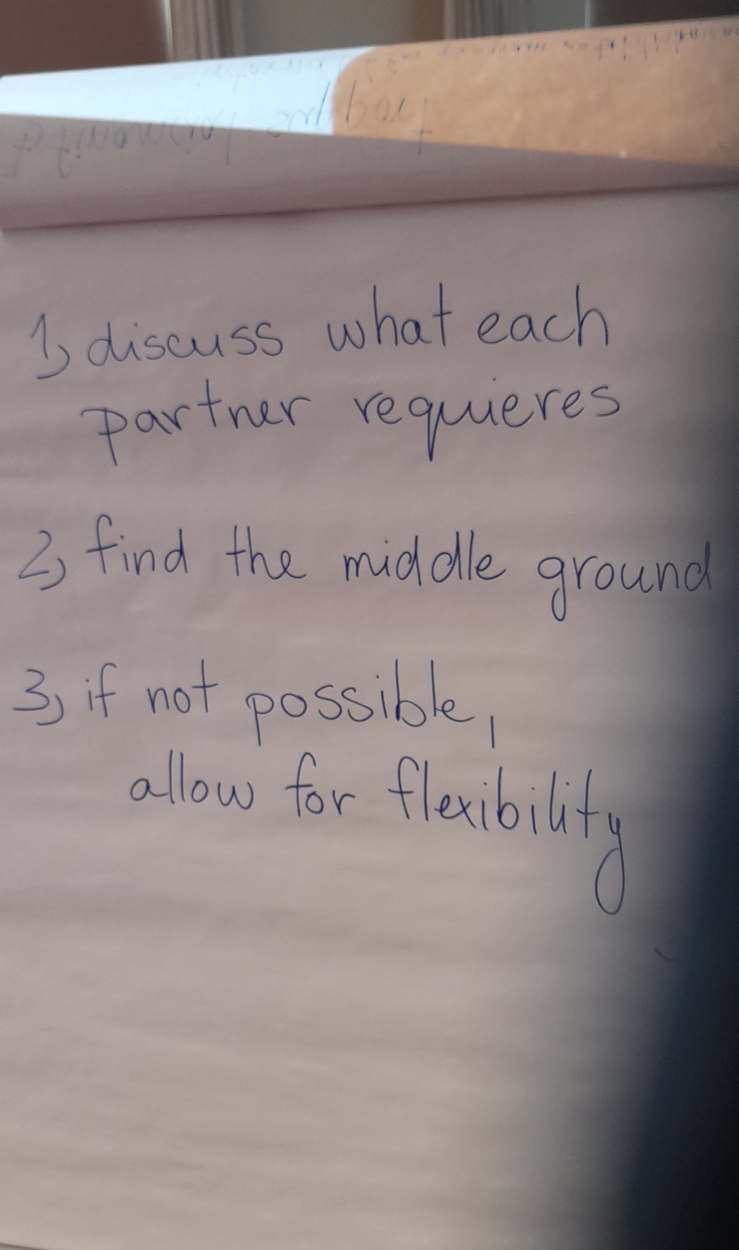

Slide 6
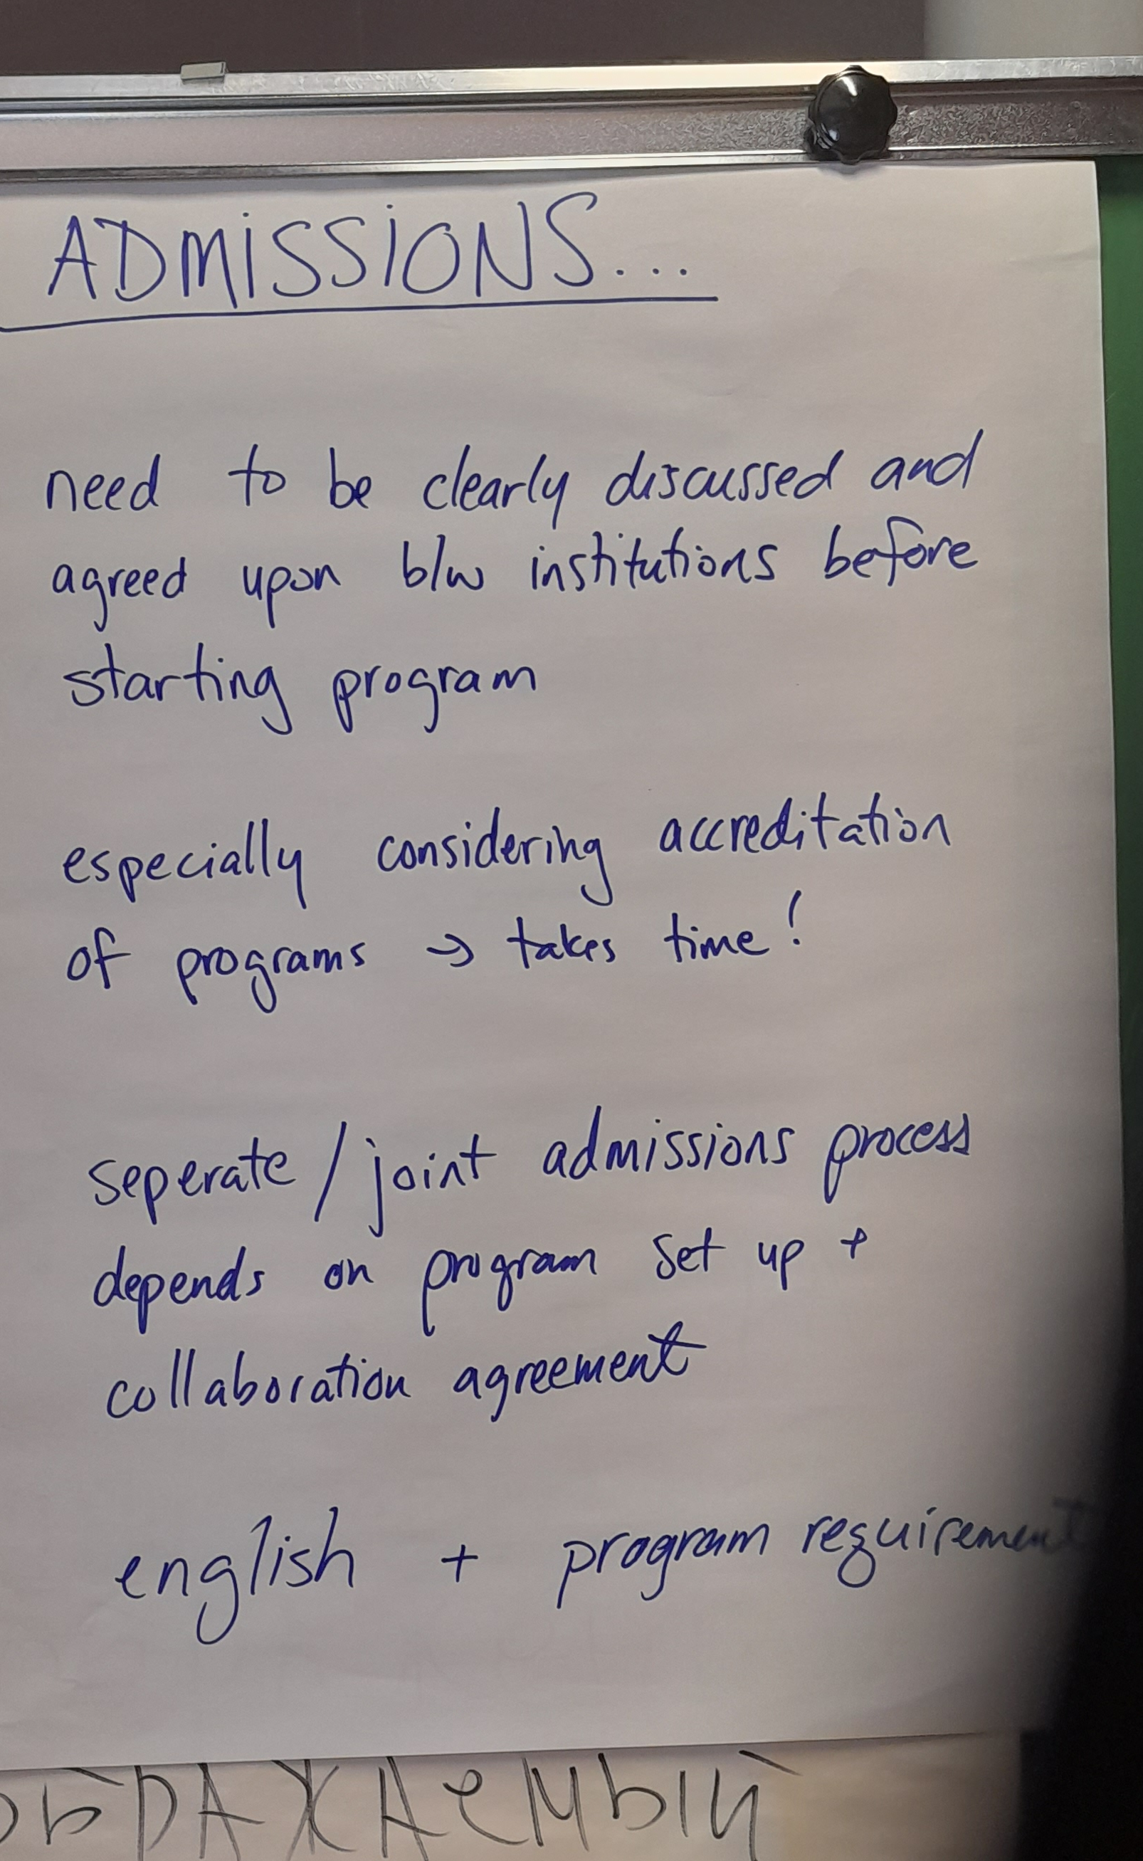
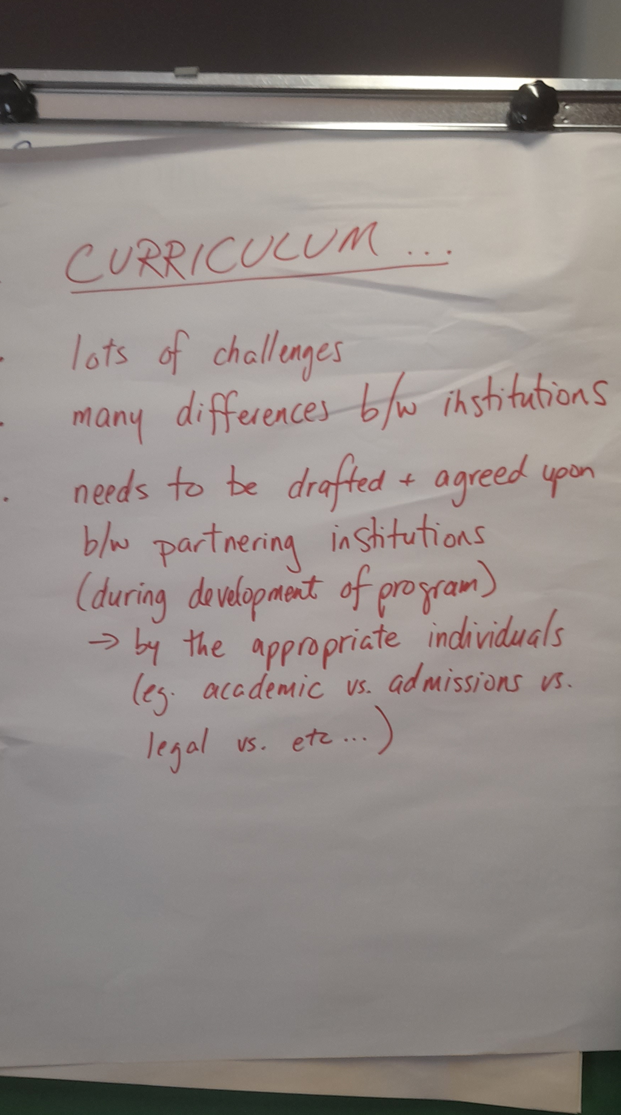

Slide 7

In a nutshell:
It all boils down to communication!
between partners and
within each partner university
And finding the happy medium
& being as flexible as possible when necessary
(within the regulations and legislation)

Slide 8

Session 4:
Future visions for International Joint Degree Programmes
European Degree Label & European Approach for Quality Assurance – global attractiveness of European degree programmes

Slide 9
Background information:
European Degree Label - Objectives & Purpose
What is the European Degree Label?
EU initiative to certify high-quality joint programmes across countries
Complements national degrees (not a replacement)
Linked to the European Higher Education Area (EHEA) and European Universities alliances
Core Objectives
Strengthen transnational cooperation
  Joint programme design and delivery across institutions
Enhance student mobility
  Built-in study periods in multiple countries
  Promote intercultural and multilingual skills
Improve academic integration & quality
  Shared European standards and quality criteria
Support automatic recognition
  Easier recognition of degrees across EU countries
Boost global attractiveness of EU education
  Position Europe as a leader in collaborative higher education

Slide 10
Background information:
European Degree Label - Key Developments & Future Outlook
Recent Developments (2022–2025)
Launch of the initiative under EU higher education strategy
Pilot projects testing criteria and implementation models (--> by 2029)
Development of common standards, including:
  Joint curricula and governance
  Integrated mobility requirements
  Shared admission and assessment systems
Exploration of a full European Degree (long-term goal)
Identification of legal and administrative barriers
Strong involvement of universities and alliances
Outlook
Label as a stepping stone towards a European Degree
Gradual scaling after pilot phase
Key role in shaping a more integrated European higher education system
Opportunities
Stronger European education identity
Increased international attractiveness
Innovation in programme design and delivery
Challenges
Differences in national regulations
Complex administration of joint degrees
Need for sustainable funding and QA alignment

Slide 11
Background information:
European Approach to Quality Assurance (EAQA)
Purpose
Facilitates quality assurance of joint programmes across countries
Reduces duplication of external QA procedures
Supports implementation of the European Higher Education Area (EHEA) goals
Key Features
Based on the Standards and Guidelines for Quality Assurance in the EHEA (ESG)
Uses a single external evaluation for joint programmes
Involves recognized QA agencies registered in EQAR
Promotes transparency, trust, and mutual recognition
Benefits
Simplifies accreditation for joint programmes
Enhances international cooperation
Increases attractiveness of European degrees

Slide 12
Background information:
European Approach to Quality Assurance (EAQA) - Connection to the European Degree Label
Link with EAQA
EAQA provides the quality assurance framework required for the label
A programme evaluated under EAQA can more easily qualify for the label
Ensures consistent quality assessment across countries
Added Value
Strengthens recognition of joint programmes across Europe
Signals excellence and high-quality cross-border education
Supports future development of a possible European Degree

Slide 13
How does the future look like for
International Joint Degrees?
- SCENARIO WORKSHOP (75 MIN) -EXERCISE BASED ON ONE OF THE MOST COMMON FUTURES RESEARCH METHODS
THEME:
International Joint Degrees in 2046
PURPOSE:
Explore possible futures for international joint degrees in Europe using a scenario matrix.
Scenarios are not predictions, but structured ways to think about uncertainty.
Scenarios help us explore different possible futures so we can make better decisions today.
No right/wrong answers
FOCAL QUESTION:
What could international joint degrees in Europe look like in 2046?
-------------------------------------
KEY DRIVERS (10–15 min) - Work in small groups (aprox 4 people) - Task: Identify 5–8 factors shaping joint degrees (e.g. policy, funding, mobility, geopolitics, technology)
- Quick sharing in Flinga (link on next slide)
Notes:
EXERCISE BASED ON ONE OF THE MOST COMMON FUTURES RESEARCH METHODS
ORIENTATIVE QUESTIONS:
How does the future look like for International Joint Degrees?
Experiences of European Quality Assurance and European Degree label development process -->Expectations and Impact --> added value vs. Costs
What kind of strong and weak signals can be detected at the moment
What kind of changes are expected in terms of global impact?
Other change makers?

Slide 14
Link to Flinga
Session name
International Joint Degrees in 2046
Access code
ELVJBFP
Join link
https://edu.flinga.fi/s/ELVJBFP

Slide 15
SCENARIO MATRIX – International Joint Degrees in 2046
AXES
Horizontal axis (→): European Approach for Quality Assurance
- Left: Weak / mainly national systems
Right: Strong / integrated European approach
Vertical axis(↑): European Degree Label - Bottom: Weak / fragmented / limited adoption - Top: Strong / widely adopted / standardised
🔵 Scenario 1:
Strong Degree + Strong QA
Fully integrated European system
Joint degrees widely trusted, seamless recognition
High mobility, strong cooperation
🟡 Scenario 2:
Strong Degree + Weak QA
Common label exists, but quality assurance varies
Trust issues between countries
More “branding” than real integration
🟢 Scenario 3:
Weak Degree + Strong QA
No common European degree label
But strong shared QA builds trust
Collaboration works “behind the scenes”
🔴 Scenario 4:
Weak Degree + Weak QA
Fragmented systems
Difficult recognition of joint degrees
Limited cooperation, high barriers
Notes:
MAIN DRIVERS OF CHANGE: 1) European Degree Label Development 2) European Approach to Quality Assurance
🔵 Scenario 1: Strong Degree + Strong QA
Fully integrated European system
Joint degrees widely trusted, seamless recognition
High mobility, strong cooperation
🟡 Scenario 2: Strong Degree + Weak QA
Common label exists, but quality assurance varies
Trust issues between countries
More “branding” than real integration
🟢 Scenario 3: Weak Degree + Strong QA
No common European degree label
But strong shared QA builds trust
Collaboration works “behind the scenes”
🔴 Scenario 4: Weak Degree + Weak QA
Fragmented systems
Difficult recognition of joint degrees
Limited cooperation, high barriers

Slide 16
How does the future look like for International Joint Degrees?
BUILD SCENARIOS (25 min) -One quadrant assigned per group.
Each group prepares a one pager with:
1. Scenario name
2. What is happening in 2046?
3. How do joint degrees work?
4. What is the student experience like?
5. What enabled this future?
6. Opportunities and challenges
PRESENTATIONS (10 min) - Each group presents (2–3 minutes)
- Short questions if time allows
REFLECTION (5 min) Discuss:
- Which scenario feels most plausible? - Which is most desirable? - What should we do today to prepare?

Slide 17
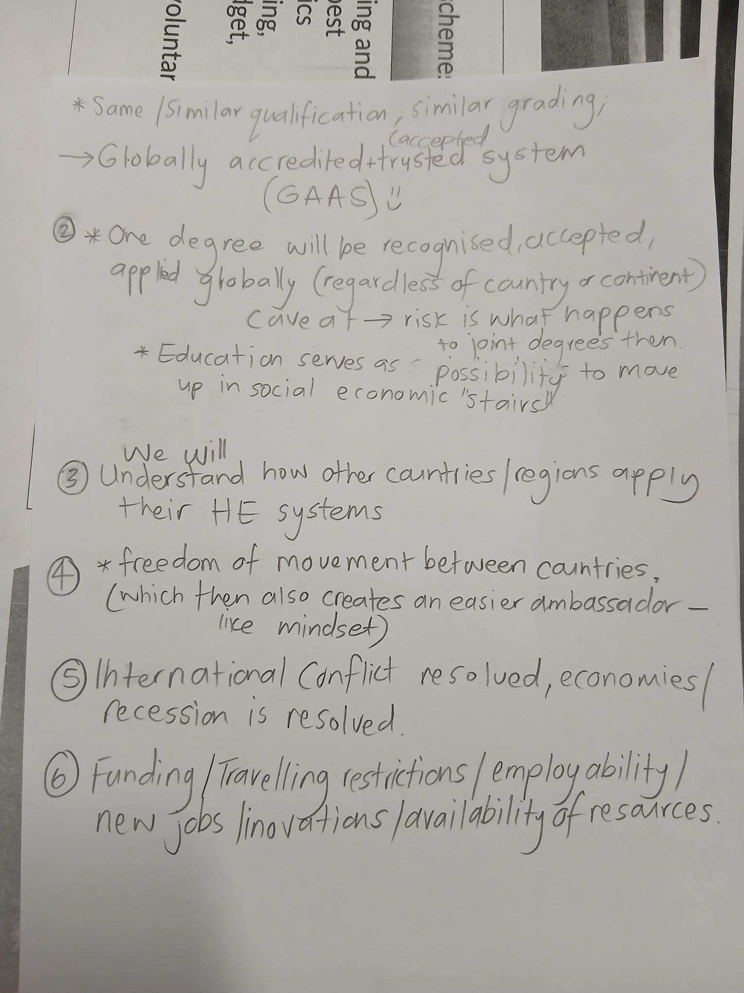
Scenario 1
"GASS = Globally Accredited and Trusted System"

Slide 18
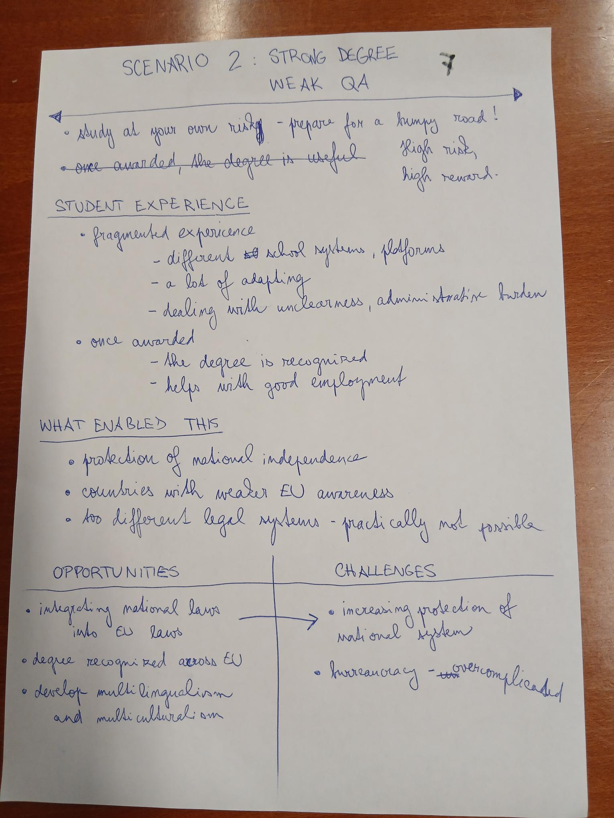
Scenario 2
"Prepare for a bumpy road!"

Slide 19
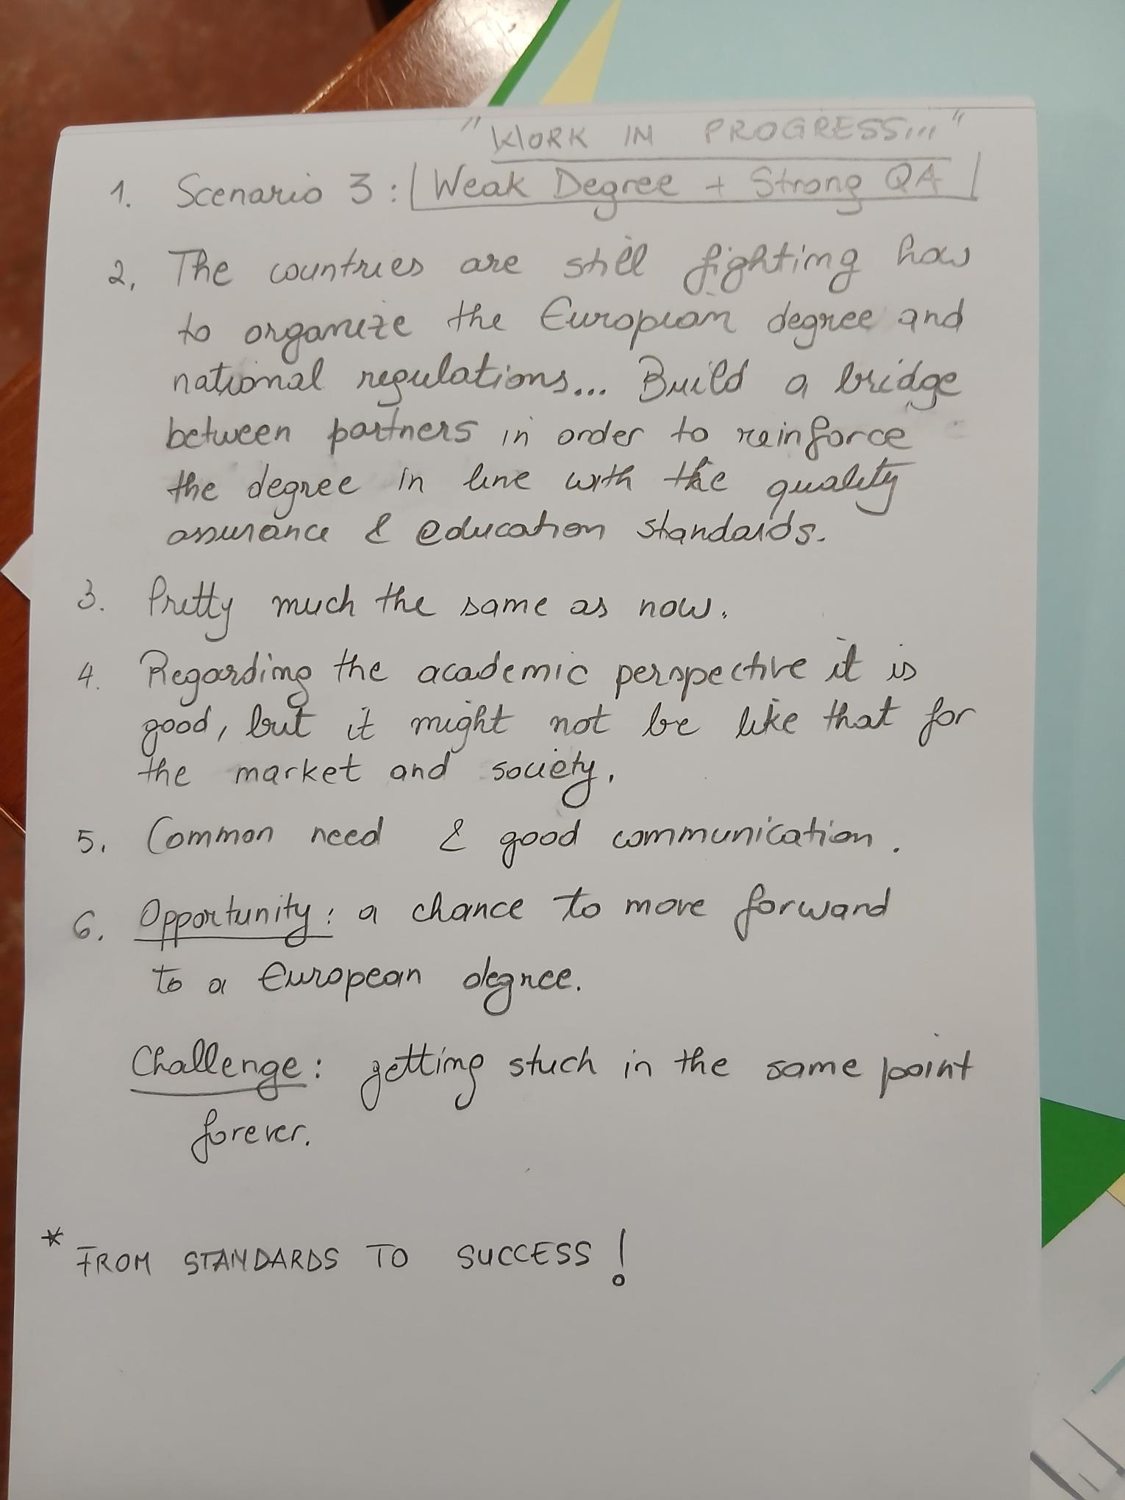
Scenario 3
"Work in Progress"

Slide 20
Scenario 4
Scenario name: Scenario 4: Europa UNMaster
What is happening
Low progress, EU is falling apart, members states are against each other, Donald Tusk is 94, he can’t remember all EU member states but well
Donald T. is the King of Poland is doing his best to implement as much joint degrees in Poland to be the top joint degree member in the EU, NAWA is supporting and financing all of it
The Emperor of the EU, a German national, ordered all the EU countries, including Canada and Australia (Eurovision) to have as many joint degres as possible (via alliances)
3. work
They don’t work
There are no students willing to go to uni, they are all influencers and youtubers
Those who join are overworked with bureocracy,
Some uniw will do degrees, some will not
There wont be funding for everyone
Two speed or multiple speed tertiary education system
4. like hell, there’s little to no support, chaos, bureocracy, people can’t finish their degrees coz of visa restrictions and border closures, and another pandemic. Mobilites frequently get cancelled
new identity of the universities – the joint diplomas are simply not necessary, everyone simply wants to study online with AI via moodle courses and then work online or not work at all, just chill all day
5. collapse, corruption, poor eu management, too many socio-econimc challenges
6. No opportunities, only challenges
theres no qa coz who undermines and questions the will of the german eu emperor
It’s the same as nowadays, just described in a fun way and exaggerated on purpose to highlight the real obstacles
"Europa UNMaster"

