Slide 1
ACADEMIC PRACTICES
@ UNIVERSITY OF
JYVÄSKYLÄ
Elisa Heimovaara
International Coordinator
Faculty of Education and Psychology

Slide 2

JY. Just add U.
Basics
Planning your studies
Registering for courses
Modes of study
Written assignments
Examinations
Grades
Contact with the staff
Questions

Slide 3
Academic degrees in Finland in a nutshell
Doctoral degree (Tohtori)
240 ECTS, 4+ years
Some courses, mainly research (dissertation) and a public defence
Licentiate degree (Lisensiaatti)
150 ECTS
Optional exit award before PhD
Master’s degree (maisteri)
120 ECTS, 2 years of full-time study
Courses and Master’s Thesis
Bachelor’s degree (Kandidaatti)
180 ECTS, 3 years
Courses and a Bachelor’s Thesis
Postgraduate studies
“Undergraduate” studies
perusopiskelija =
”basic degree student”…

Slide 4
Course credits (ECTS)
What is included in a credit?
  All the “learning” for the course:
        Contact teaching, e.g. lectures/seminars/demos…
      Group/pair work
      Exams, essays, assignments and the time to prepare
      Any other independent work
  For example: a 5 cr course is 135 hrs of work (17 full 8 hr working days), including all the work
ECTS = European Credit Transfer and Accumulation System
1 ECTS = 1 JYU credits or opintopiste (op)
= 27 hrs of work
An academic year = 1600 hrs of work
= 60 credits
A semester = 30 credits

Slide 5
Academic calendar
Autumn semester 2026
I period: 1.8. - 25.10.2026
II period: 26.10. - 31.12.2026
  Christmas break 18.12. – 10.1.2027
Spring semester 2027
III period: 1.1. – 21.3.2027
  teaching starts on 11.1.2027
IV period: 22.3. - 30.5.2027
  Easter break: 22.3. - 29.3.2027
Summer period: 31.5 - 31.7.2027 (holiday; very limited teaching)
JYU is closed on national bank holidays:
  Finnish Independence Day (6 December)
  Christmas (24-26 December)
  New Year’s Day (1 January)
  Epiphany (6 January)
  May Day, “vappu” (1 May)
  Ascension Day (6 May in 2027)
  Mid-Summer’s Eve, “juhannus” (25 June in 2027)
July: Finland is ”closed” (from Mid-Summer’s Eve (juhannus) in late June to early August)

Slide 6

1. Planning your studies
Sisu?
Personal Study Plan
Choosing your courses

Slide 7
Sisu?
The master study data system
Both in Finnish and in English; choose your language
For students:
  Course descriptions
  Personal Study Plan through “Structure of Studies” (e,g, exchange studies at EDUPSY)
  Registration for courses (completion methods) and exams
  Official Transcript of Records and Certificate of Registration
Keep your e-mail address and other contact information up-to-date!
Technical problems with SISU → contact SISU support (HelpJYU Service Portal)
Full instructions: https://www.jyu.fi/en/for-students/instructions-for-bachelors-and-masters-students/it-instructions-and-tools-for-students/sisu-instructions

Slide 8
Personal study plan in Sisu
Your plan for your entire stay
In “Structure of studies” in Sisu
The overall structure i.e. the outline (and possible compulsory parts) of the Study Plan is already in Sisu. However…
… A lot of optionality too…
  from your own Department and/or Faculty
  also from other Faculties and the Centre for Multilingual Academic Communication (Movi)
  (check availability and possible restrictions)
  Consult your home university too
A tool for you: keep track of which studies are “to do” and which studies have already been completed

Slide 9
Choosing a course
All courses can be found in Sisu (translated in English) but not all courses are open for you! Always check the course info and the Completion Methods: is it actually available for you and is it taught in English? Check:
  Language of learning
  Subject specific restrictions (e.g. JSBE by level)
  Level (course code!)
  Prerequisites?
  Sometimes teaching is in Finnish but int’l students are allowed to complete the course by independent study in English (alternate year delivery, for example)
Courses at the Centre for Multilingual Academic Communication (Movi)
  French? Swedish? Academic writing, courses in intercultural communication and plenty more!
  https://www.jyu.fi/en/for-students/instructions-for-bachelors-and-masters-students/studies-at-movi
Study Guide with all curricula, e.g. Creating Careers (Joint studies)
Courses available in English listed at:
  https://www.jyu.fi/en/apply/student-exchange/courses-for-exchange-students
  An easy access list of courses delivered in English across Faculties
  Some courses (clearly marked available to “all”) are available to students from other faculties

Slide 10
Course codes can guide you
The first 3 digits of the code usually express the host subject (in Finnish), the 4th digit expresses the level of studies:
Example: PSYS1234 = A Master’s level Psychology course
Examples of subjects:
PSY = psykologia (=Psychology)
TIE = tietotekniikka (= Computer Science)
XEN = X for Movi, English language
Levels:
xxxPxxx = Perus = BA/BSc basic (1st year)
xxxAxxx = Aine = BA/ BSc intermediate (2nd-3rd year)
xxxSxxx = Syventävä = Master's level (Advanced)
xxxJxxx = Jatko = Doctoral level
xxxMxxx = other studies
xxxOxxx = orientation studies,
xxxYxxx = general studies

Slide 11

2. Registering for courses
Course and completion method
When to register?

Slide 12
How, where, when, what?
In Sisu
A course is designed for a full curriculum period for several years (2024-2028) but teaching schedules are decided annually!
  You register for a certain completion method (of a course) available during that semester
Courses may have more than one completion methods
  Taught and independent option
  Different completion methods for different groups (e.g. language courses for different programmes)
A course may have separate registration for lectures/exams/demos!
Please cancel your registration if you change your plans!

Slide 13
When to register for courses?
When your University user license is fully functional and you can access Sisu
Registration deadlines vary and you may not be able to register yet for courses which start later in the academic year
Registration period and deadline for a course can be found in the Completion Methods tab of the Course Description in Sisu
Course registration
    Include courses in your Study Plan, i.e. Structure of Studies → schedule
    Register for those courses which you will be timing for that period/semester
Study Plan is for the entire duration of your studies and the course registrations are done as and when the time is to take them!
Separate session on Sisu!

Slide 14
Important to Notice
Possibly overlapping schedules; no ready-made timetables for students
Do not miss the first lecture; all the important information is given there! If not possible, please ask!
Academic quarter of an hour…14:00 or 14:15?
Attendance requirements vary; check with the lecturer!
Class sizes vary (10-400)!
Teaching methods vary!
Depending on your Faculty, courses available also online, possibly including small group meetings

Slide 15

3. Modes of study
Vary from Faculty to Faculty, programme to programme and course to course

Slide 16
Teaching methods
Courses can have different completion methods, i.e. how to complete the course (e.g. participating in teaching/independent study)
Courses may include different teaching methods such as
  Seminars
  Demos/labs or practical work
  Group work, working in pairs
  Presentations
  Online teaching/support
  Lectures
  Book exams
  Assignments, essays and reports, learning diaries
https://www.jyu.fi/en/for-students/instructions-for-bachelors-and-masters-students/completing-studies

Slide 17
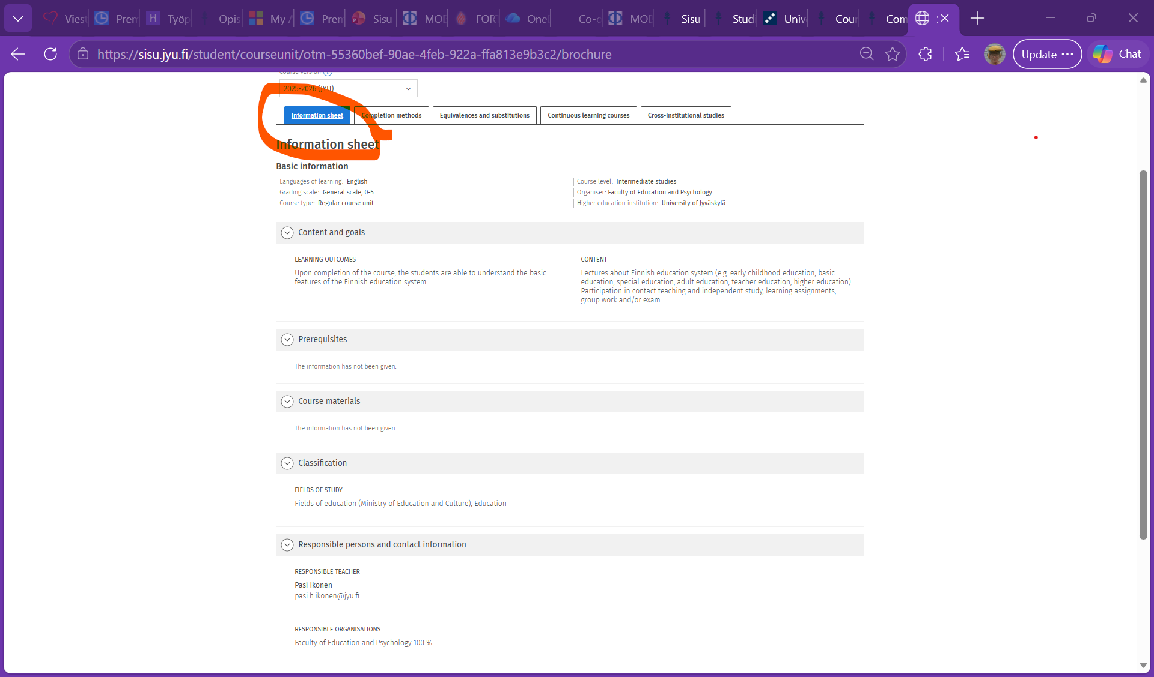
Example of a course outline

Slide 18
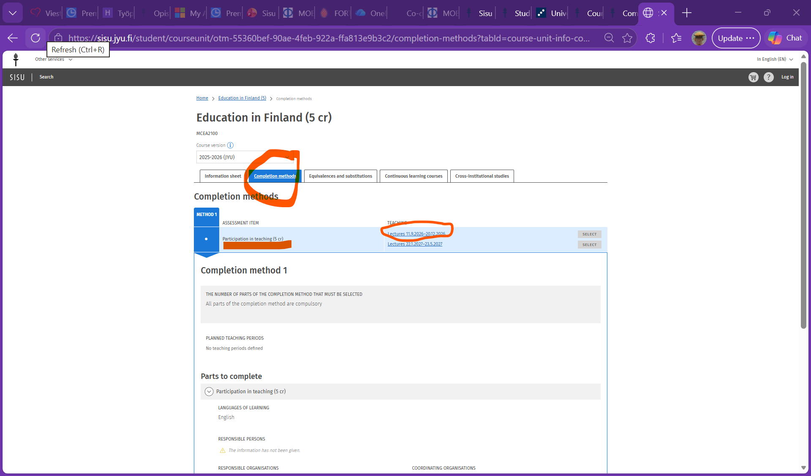
Completion method

Slide 19
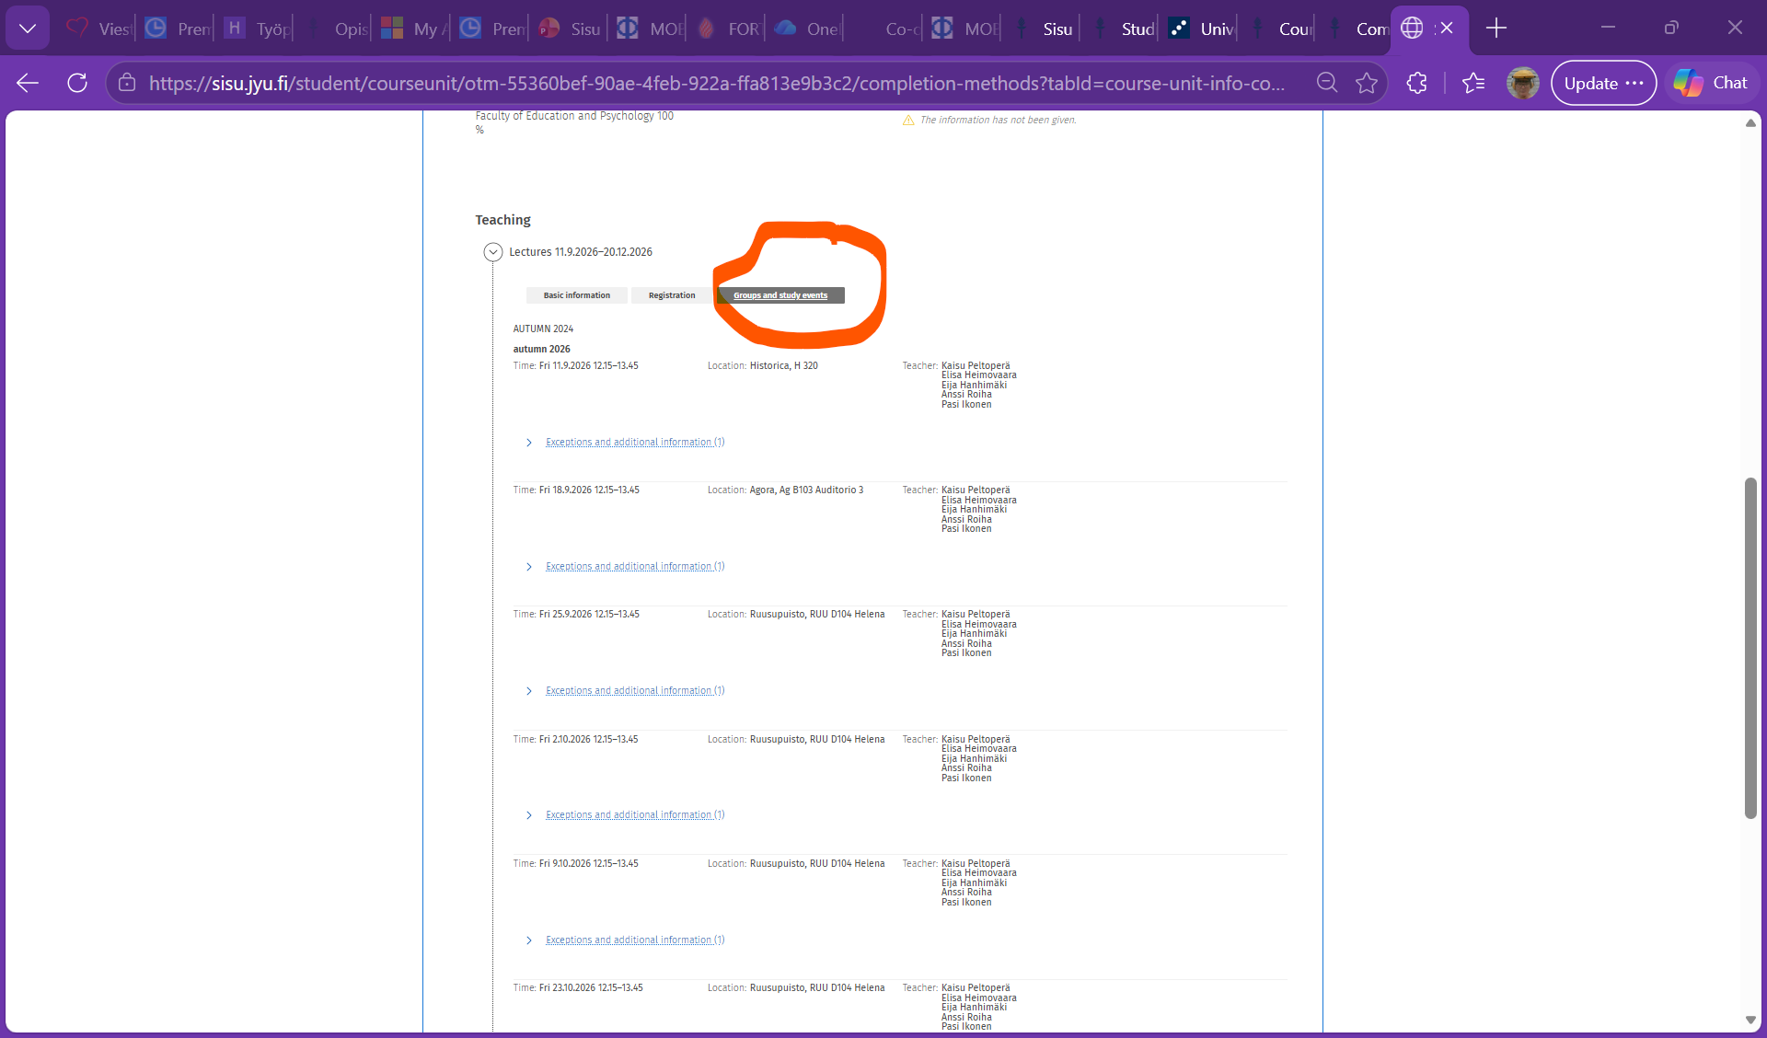
Timetable & locations

Slide 20

4. Written assignments
Cultural differences
Plagiarism
AI

Slide 21
What to pay attention to?
Great cultural differences on
  Structure
  Style
  Referencing
  https://www.jyu.fi/en/for-students/instructions-for-bachelors-and-masters-students/information-seeking-and-research-data-management/library-tutorial/how-to-cite
Be aware of your own background and differences in academic culture and writing conventions!
Submission methods may vary but mainly by Moodle
Check deadlines

Slide 22
Academic misconduct
Fraud means:
Plagiarism means:
Cheating (e.g. talking!) on an exam;
Copying an assignment;
Giving a fellow student your work to present it as their own;
Taking an exam for someone else;
Fabricating measurements or other findings.
Copying someone else’s work either directly or in a modified form (incl. summarizing or translations) without properly naming the source!
It must be clear for the reader at all times which part of the text is borrowed, what is the cited publication/ material, and to which section of the publication or material the citation refers to (e.g. page numbers).
REFERENCES!
Consequences: automatic fail, disciplinary actions, notifying home university

Slide 23
JYU Code of conduct for academic misconduct…
Ethical guidelines for studying and the handling of academic misconduct: https://www.jyu.fi/en/for-students/instructions-for-bachelors-and-masters-students/regulations-and-directives-guiding-studies/dealing-with-academic-misconduct
Ensure you know how to avoid misconduct!
Plagiarism detection software is in use

Slide 24
Use of AI
University’s general guidelines for the use of artificial intelligence (AI) applications (2023): https://www.jyu.fi/en/for-students/instructions-for-bachelors-and-masters-students/regulations-and-directives-guiding-studies/using-ai-based-applications-in-studies-jyus-instructions-and-guidelines
Using AI-based applications to assist in studies is allowed in principle
  E.g., for making drafts, structuring topics, understanding concepts or to assist in language and text issues for further work by you!
The teacher gives final instructions on the use of the AI applications
AI is not a scientific source!
  AI is not a scientific source! You must always clearly state if you are using text produced by an AI application. You must always refer to the original source according to required reference practices. The use of AI must also be indicated in the bibliography.
The student is responsible for the content of the text they hand in!
  Be careful if you use AI. It cannot be used in assignments where linguistic presentation is part of the assessment criteria. Directly quoting the text produced by the language model without using references is plagiarism. The plagiarism detection programmes will detect the use of AI.
If generative AI have been used in completing assignments/theses, the application and how it was used, must be mentioned
  assignment can be, e.g., an exam answer, an essay, or a thesis. State the use of AI for the text, its topic or language issues in the introduction. If the description is very long, you can also use a separate attachment to report it.
Further guidelines from your Faculty/programme!

Slide 25

5. Exams
Lecture exams
E-exams
Book exams
General exams
No oral exams (excl. languages)

Slide 26
About exams
Not all courses have exams; subjects vary a lot
Retakes are available if you do not pass, or you wish to raise your grade
After 2 no-shows/failed exams, you must consult the teacher about the possibility to take the exam
Only a certain number of books/ebooks are available in the University library; please plan ahead…
Different types of exams

Slide 27
Lecture exams and book exams
Lecture exams (luentotentti)
Book exam (kirjatentti)
A part of the course; for most courses at the end of a course/period
Dates for exams and re-exams stated in Sisu in the course description
Registration for Tentti (= exam) in Sisu
If you cannot attend: discuss with the teacher beforehand!
Book exam can be:
  a part of a course with contact teaching or
  the only mode of studying of an independent study course, i.e. no lectures, just books to study!
Can be done in eExam or Moodle, for example

Slide 28
eExam and a general examination
eExam
General exam (yleinen tentti)
An electronic exam that you can take independently in an eExam room
Some (not all) exams can be taken as eExams
Locations in Agora and Lähde (library)
You can choose the time for the exam from the reservation calendar
  Mon-Fri 8:00-20:00 and even on Saturday till 16:00
Registration in the eExam system
E-exam Guide
Only used in the Faculty of
  Information Technology
  Mathematics and Science
  Jyväskylä School of Business and Economics
Organized once a month
For each general exam date there is a list of exams (courses) you can take that date, registration in Sisu
https://www.jyu.fi/en/for-students/instructions-for-bachelors-and-masters-students/completing-studies/general-examinations

Slide 29

6. Grades
Grades within two weeks of submission, results in Sisu
1-5 scale
Re-assessment

Slide 30
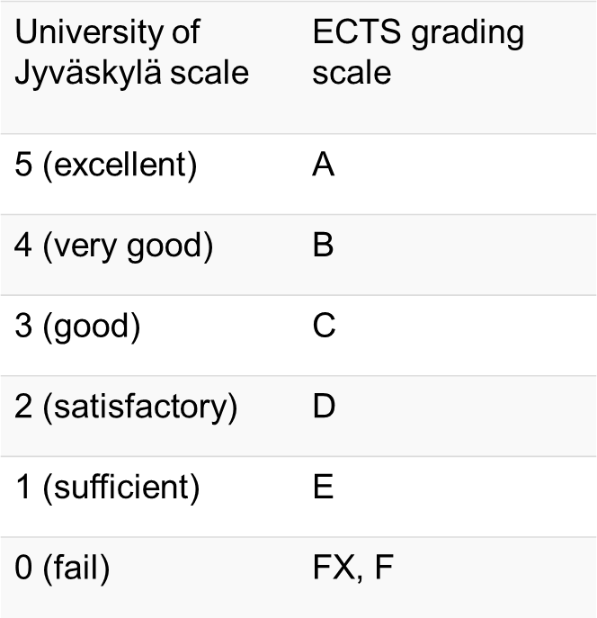
Grades
The full scale 1-5 is used
Failed or dropped courses do not show on the ToR
Some courses may be graded Pass/Fail
- not possible to change the grading scale; check whether your home university accepts Pass
Re-assessment has no effect on the final grade, i.e. there are no automatic reductions on grades due to a resit

Slide 31
About grades
“Normal distribution” is NOT used, i.e. all students can get a 5, if they do well
No University level assessment criteria
Grades and credits do not have any connection, i.e. all students will receive the same number of credits for the same amount of work; only the quality work is assessed by different grades
Students are not usually compared with each other on the basis of their grades
Students are allowed to improve their grades through reassessment
  the best grade will prevail

Slide 32
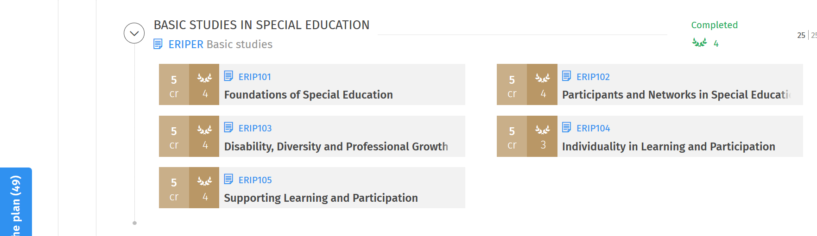
Where to find the results?
Results are published within 2 weeks of completing an assignment or exam.
Results will appear in SISU study plan &
in the Completed Credits section (My Profile → Completed credits)

Slide 33
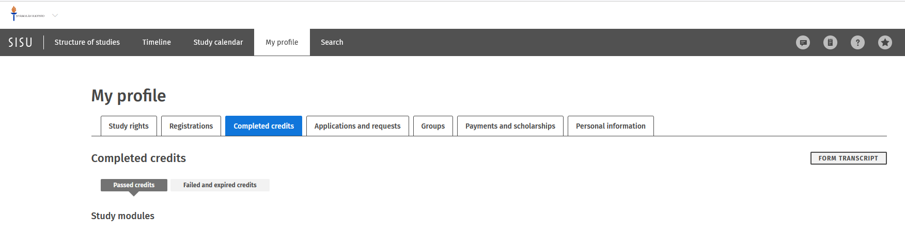
Transcript of records
Includes all courses you have successfully completed at JYU
Includes credit values and grades
Does not include courses you have failed or cancelled
You can get a digitally signed, official ToR at any time by downloading it from Sisu

Slide 34
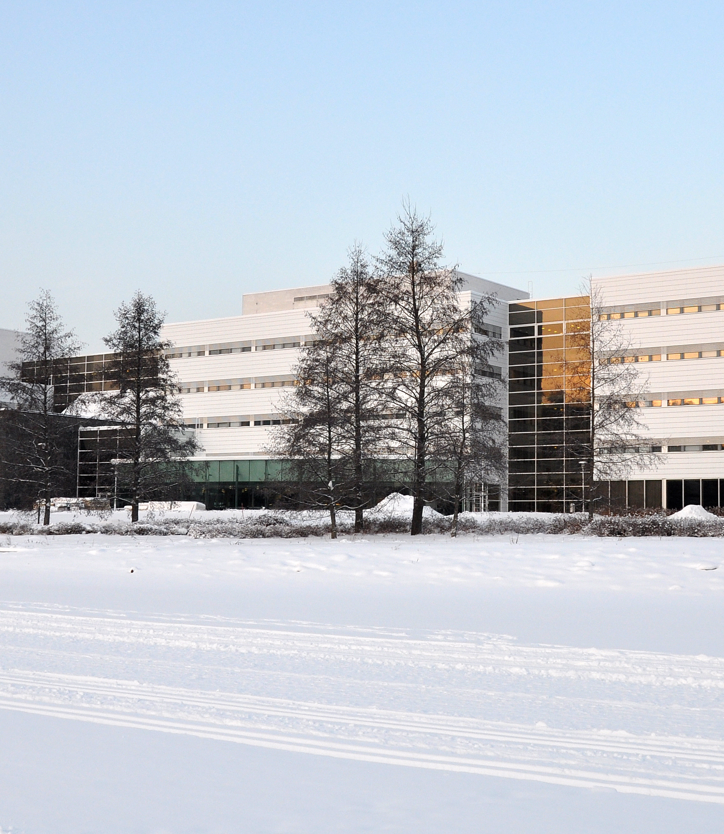

7. Contact with the staff
JYU Main page: https://www.jyu.fi/en / Contacts
Administration through HelpJyu
Rights and responsibilities
Please be patient; please do not expect an immediate response

Slide 35
Academic atmosphere
Low hierarchy: casual but respectful relationship between students and staff
Students often call their teachers by their (first) names, not by their titles
  The informal ”you = sinä”, is generally used instead of the formal address, “You = te”
You can contact teachers/professors directly
You can ask for feedback about your performance directly from teacher
Feedback collected at the end of each course
Staff have weekly appointment hours or appointments are agreed by e-mail
E-mail conduct: be precise (help us to help you!)
  state the topic clearly in the subject field, e.g. mention the code/name of the course or other important details
  use your first and last name as written in Sisu
Please allow enough time for the staff to answer your e-mails, do not expect an immediate answer
HelpJYU used by student services (not teachers)

Slide 36
Academic freedom and responsibility
Freedom and right to think and learn and make choices in your studies… and teaching!
Flexibility in the system
Responsibility to plan & organise: be in charge!
No strict control over students
    … but this does not mean that there are no rules!
Expectation of mature and independent behaviour
Remember to ask if something seems unclear
With freedom comes responsibility…

Slide 37
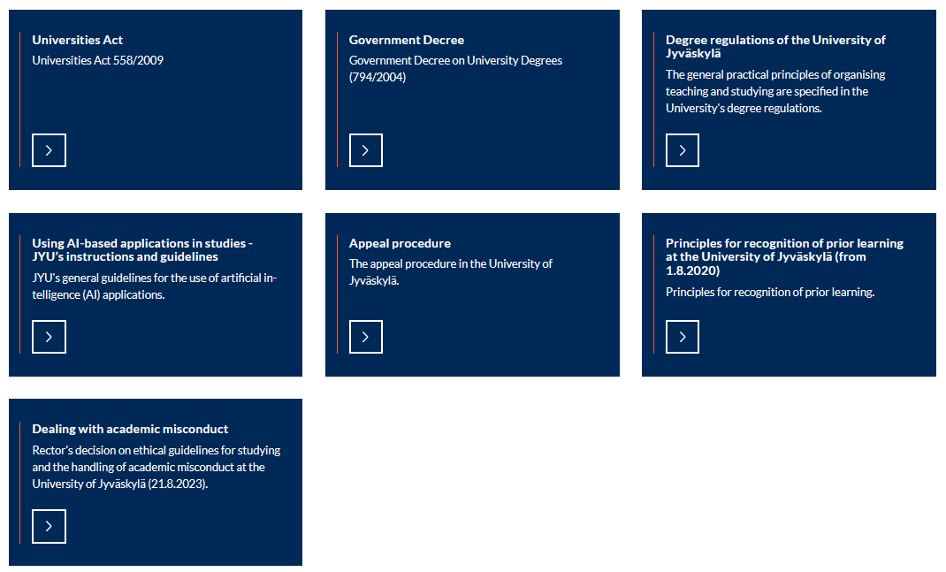
Regulations and directives guiding studies
Studies are regulated by national legislation and internal JYU decisions
https://www.jyu.fi/en/for-students/instructions-for-bachelors-and-masters-students/regulations-and-directives-guiding-studies

Slide 38
Where Can I Find Information? Who Can I Ask?
Study: https://www.jyu.fi/en/for-students/instructions-for-bachelors-and-masters-students
  all information is readily there
HelpJyu Service Portal: https://help.jyu.fi/ Tools tab on the University website
  Administrative matters, such as exam arrangements, certificates…
Your programme staff, esp. Study Advisor/international coordinator (most of you will meet them on Thursday!)
Course teachers
  Any course specific queries (assignments, grades, attendance, etc.)
Your peers in your community
  Tutors, Student Union (Subcommittee for International Affairs), Subject Associations, ESN

Slide 39
Goodies at your service!
There may be bumps on the road: you’re not alone!
The Goodies, i.e. wellbeing advisers, are there for you when you need someone to talk to
  Trained members of staff to offer support
  Come with any issue or problem, “big or small”
  Always confidential
  Here to find solutions to your situation together or to just “lend an ear”
  More about the Student Life concept, the Student Compass and Goodies at: https://www.jyu.fi/en/for-students/instructions-for-bachelors-and-masters-students/student-wellbeing
  Separate session!

Slide 40
Keep informed!
JYU For students: https://www.jyu.fi/en/for-students
  All guidance from new student handbook to graduation
JYUsletter – all the current news/events/general deadlines etc. Read it!
Mailing lists for international students/exchange students
Faculty/Departmental mailing lists for all students
  Automatic for all degree students, not routinely translated and not all information is relevant to you
Facebook
  ESN Jyväskylä…

Slide 41
8. Questions
Ask!
Get involved!
Explore!
Enjoy!

Slide 42

Welcome to JYU!

